Slide 1
7/2021/5565
Land south of St. Marys Green, Crosthwaite
Two dwellings and footpath - outline application

Slide 2
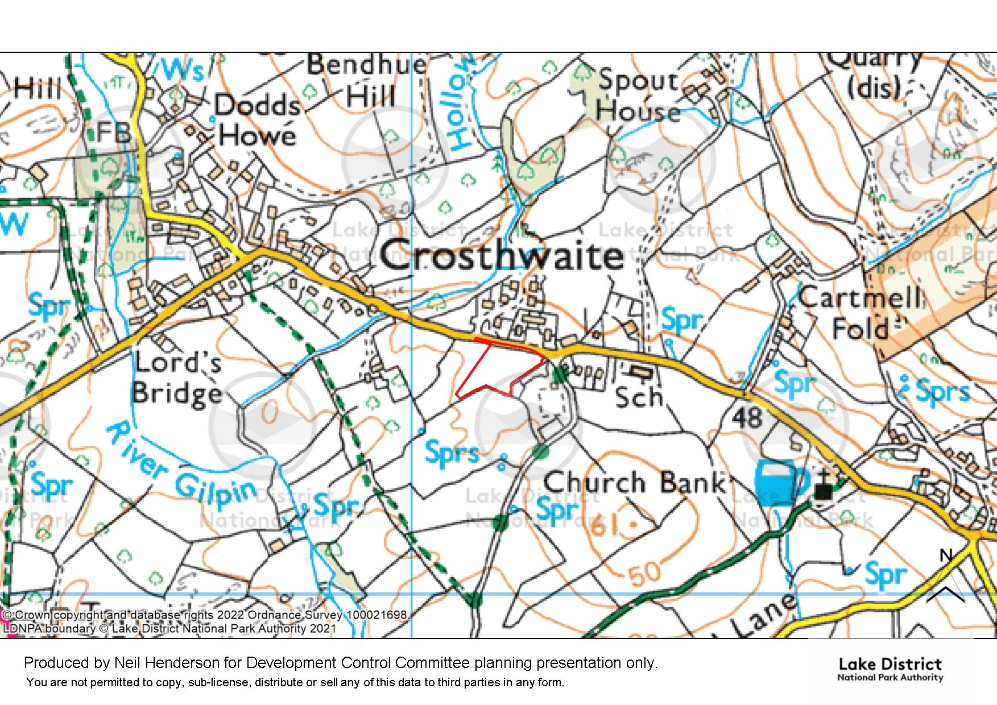
Slide 1
Application site

Slide 3
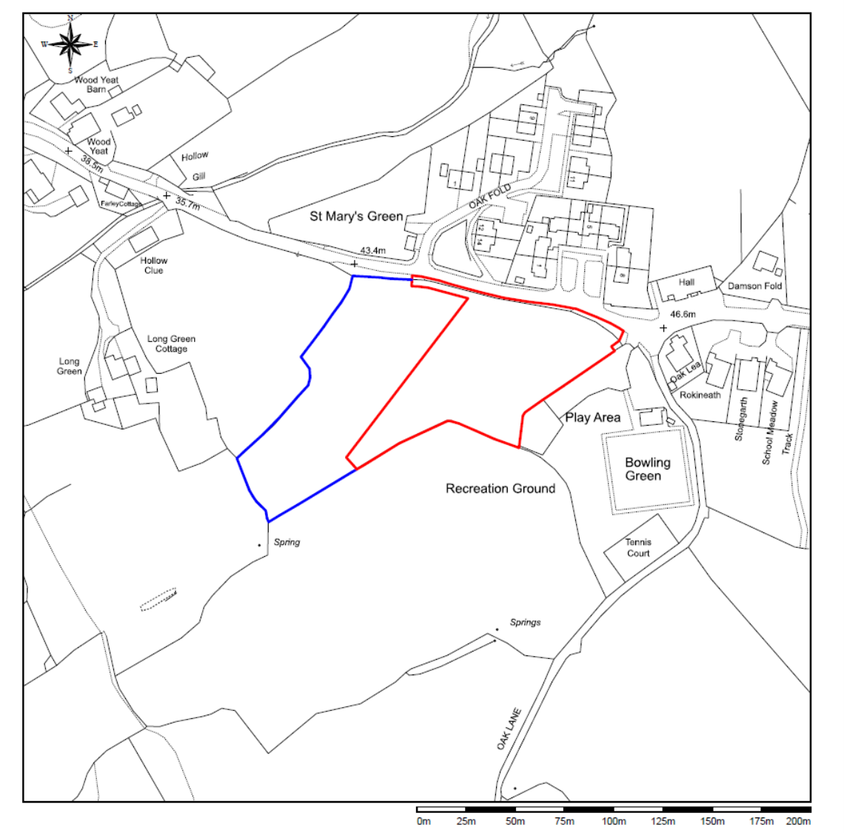
Slide 2

Slide 4
Entrance to Oak Fold
Slide 3
Entrance to St. Mary’s Green
Indicative Layout

Slide 5
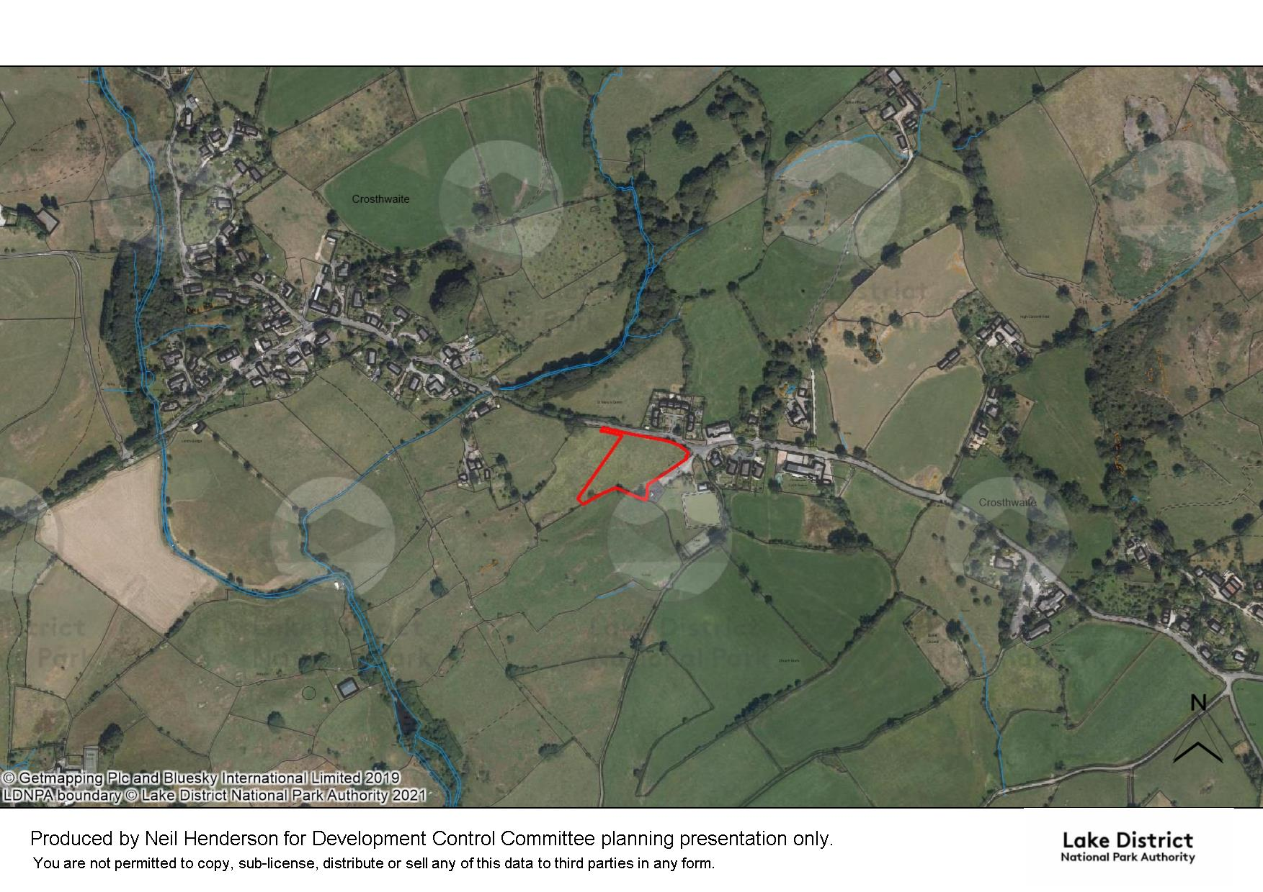
Slide 4
Oak Fold
Approx. line of completed footpath

Slide 6
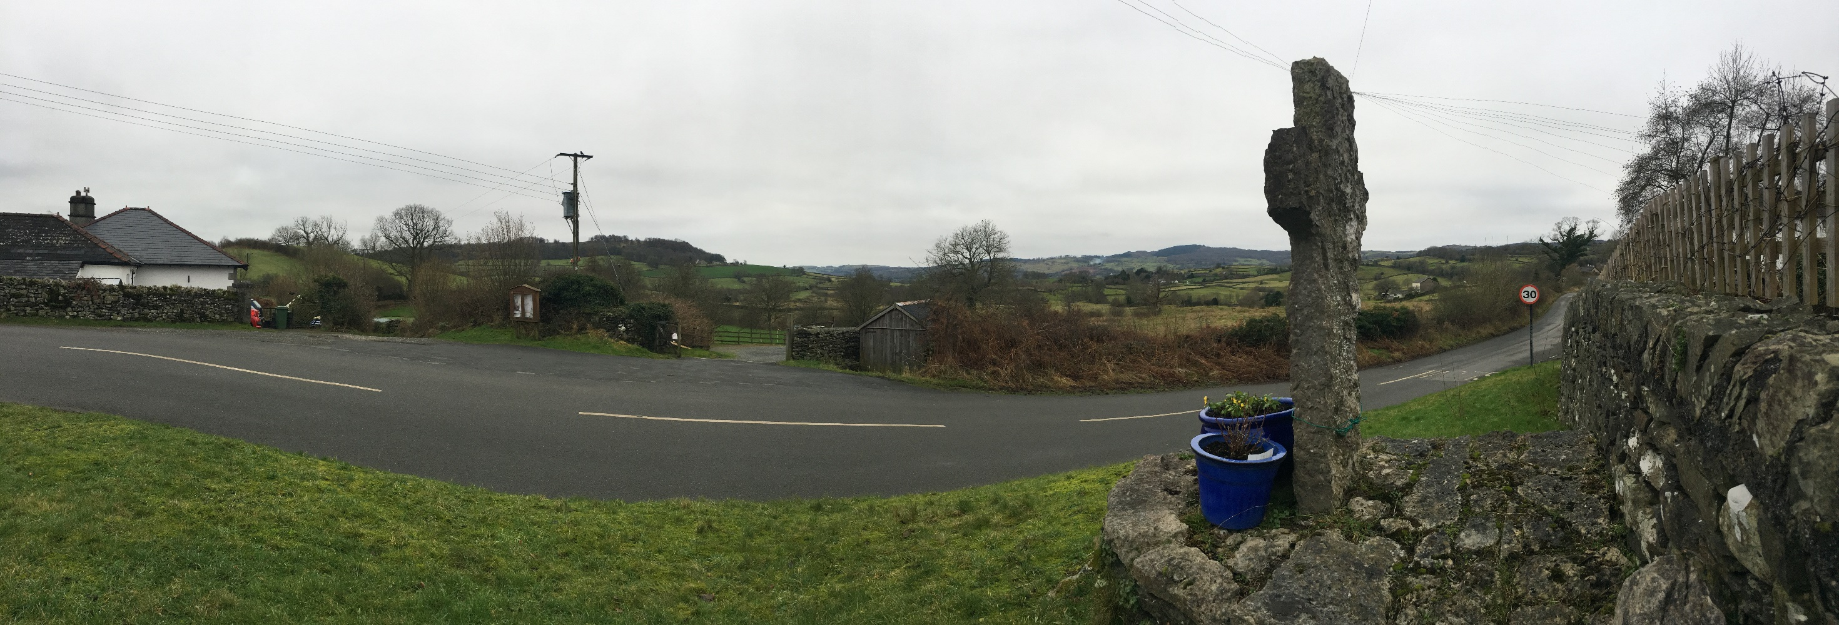
Slide 5
Approximate position of site
Panoramic view from Millennium Cross seat towards site

Slide 7
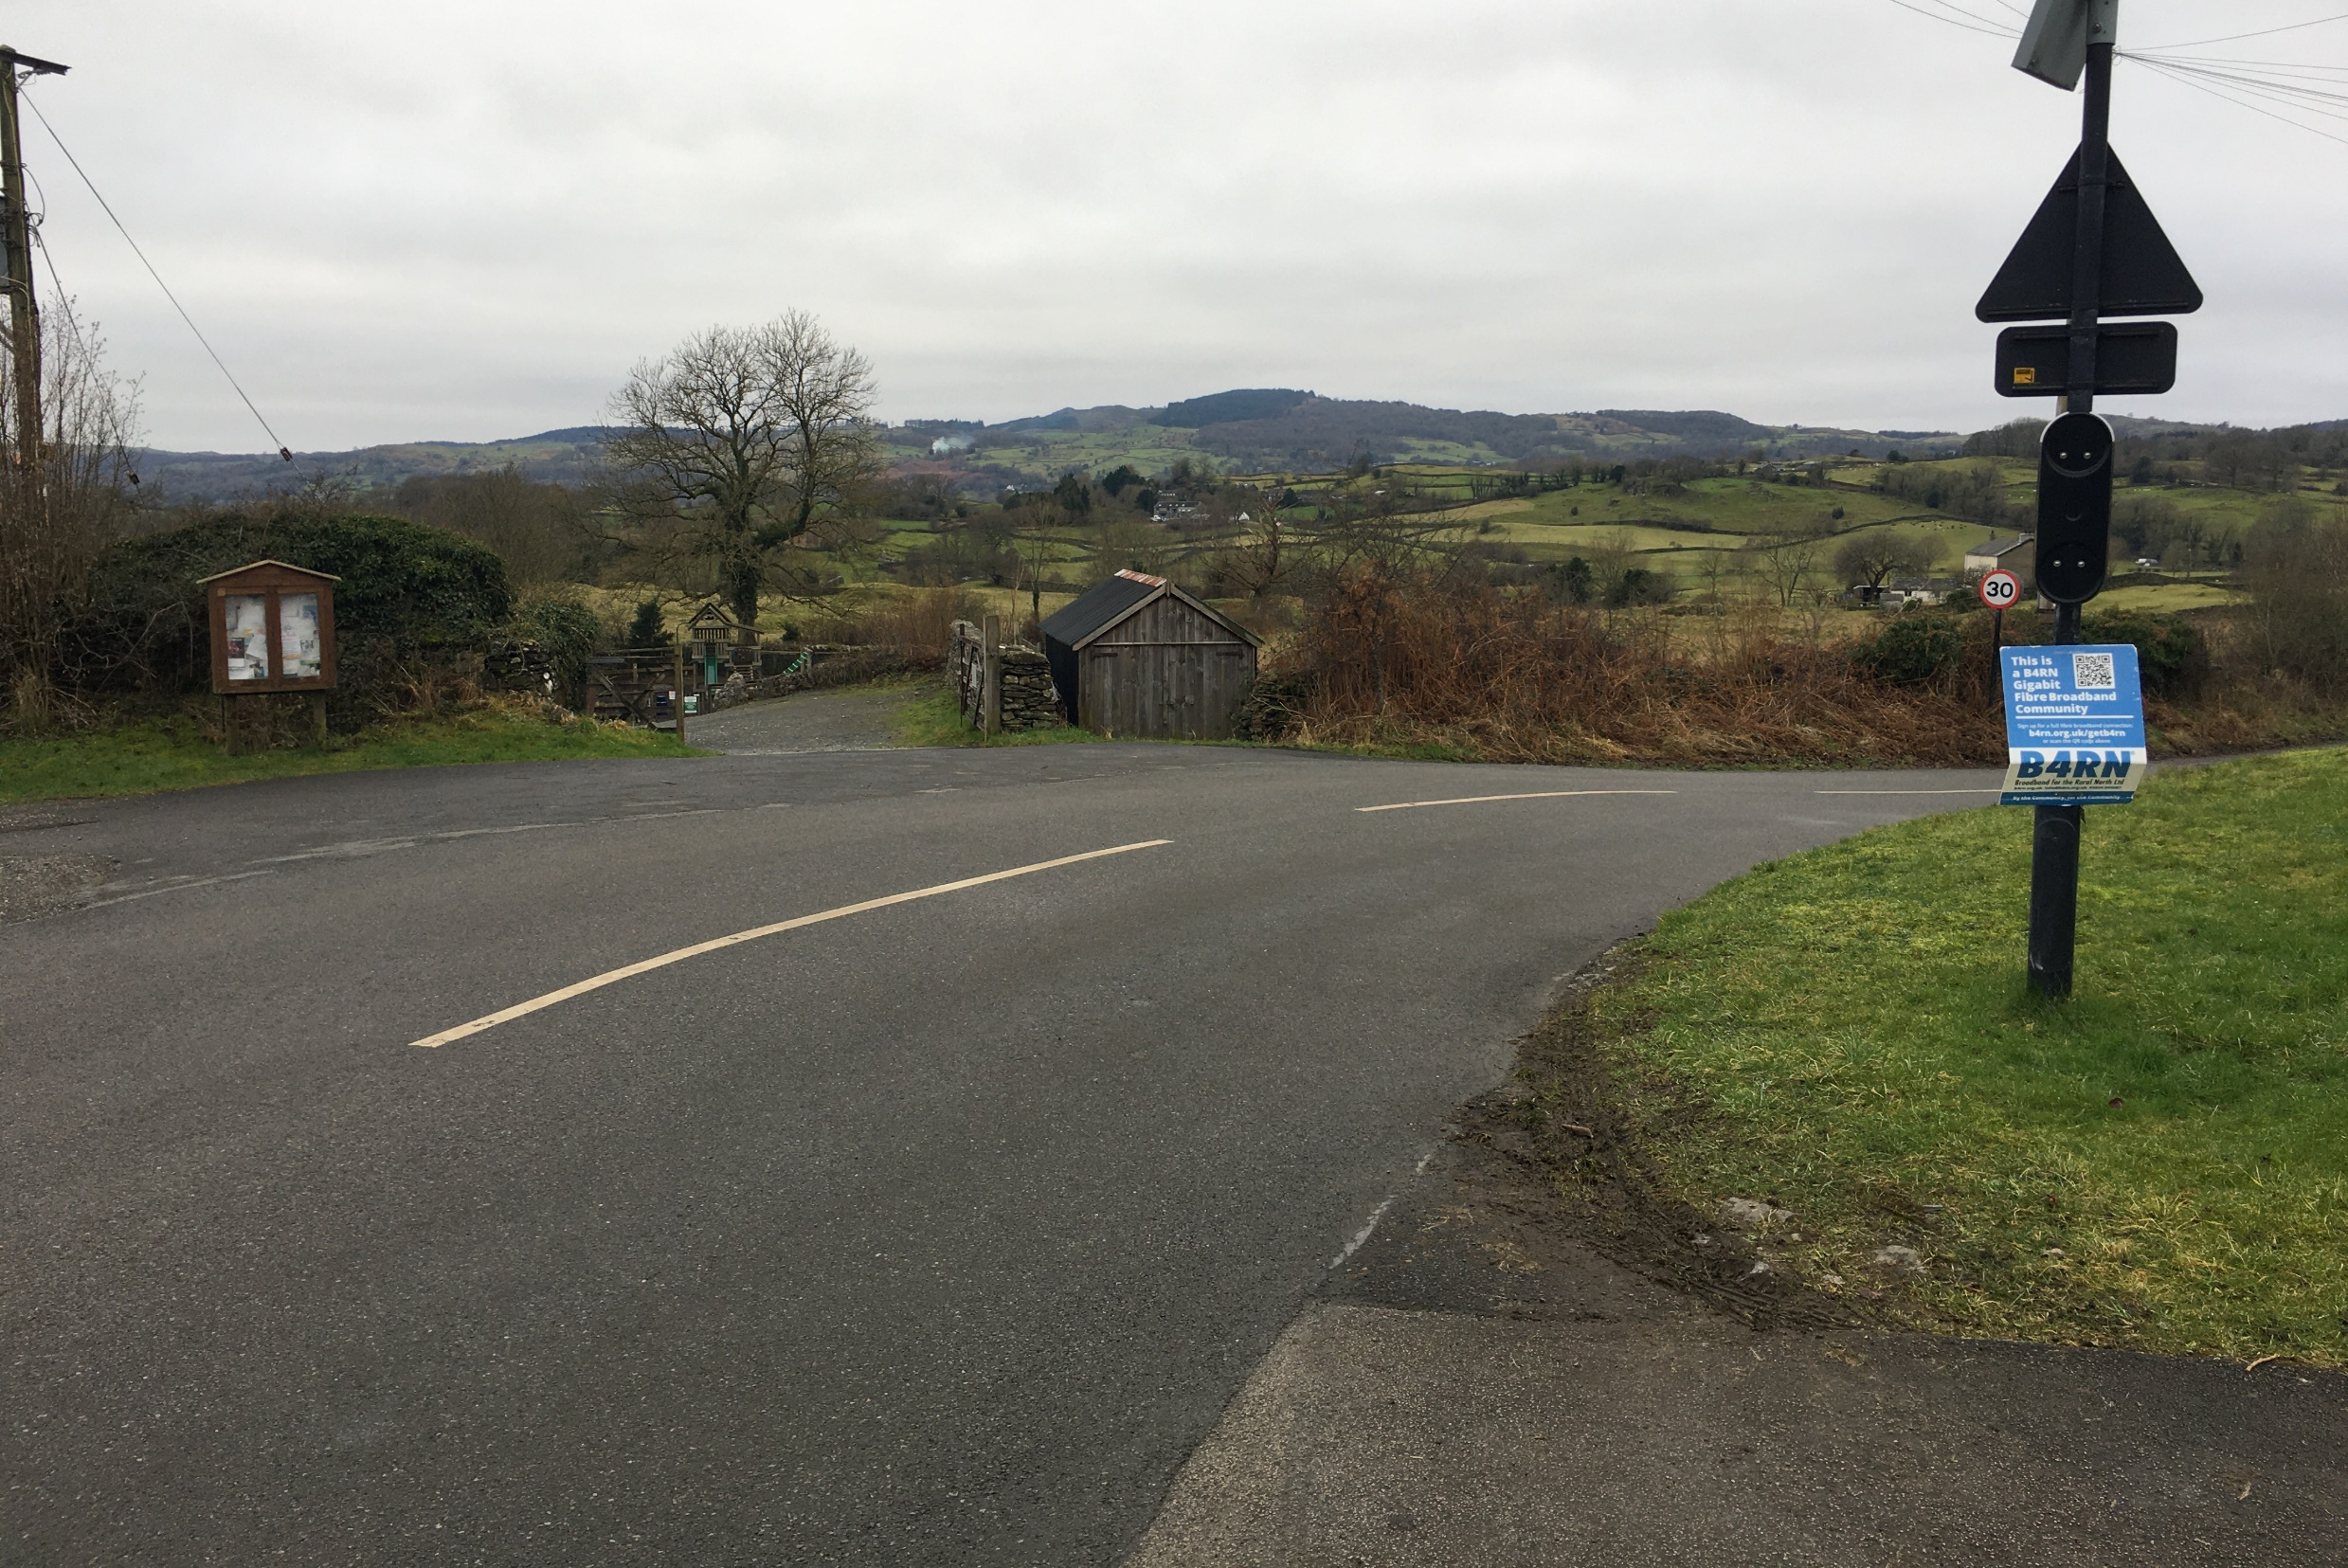
Slide 6
View from memorial hall towards site

Slide 8
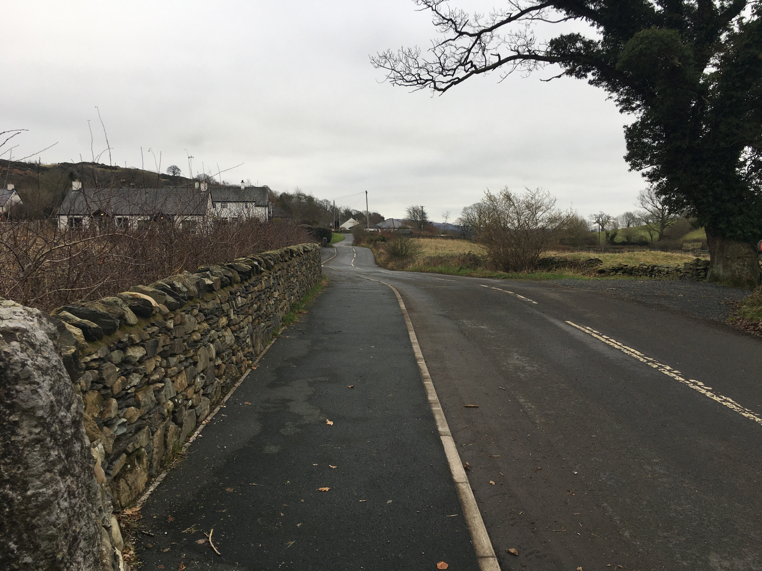
Slide 7
View east towards site from entrance to Oak Fold

Slide 9
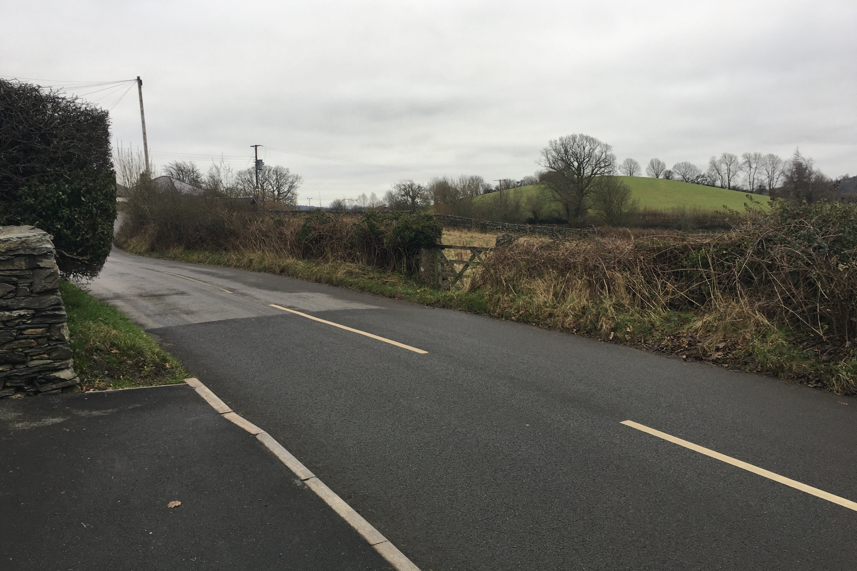
Slide 8
Approximate position of indicative access
View towards site from boundary
between St Marys Green and Oak Fold

Slide 10
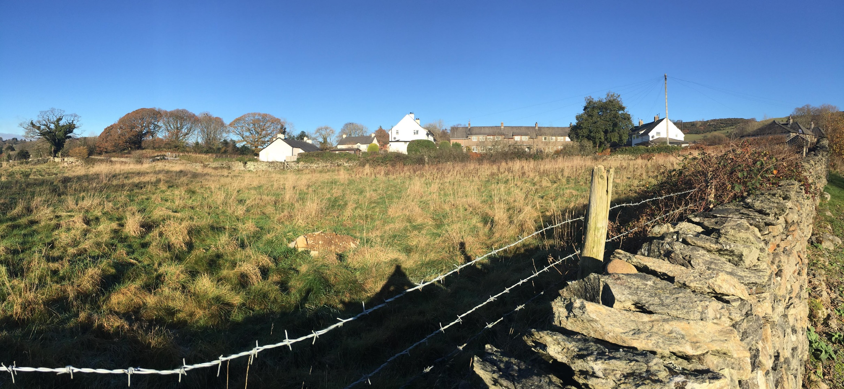
Slide 9
Memorial
Hall
Oak Fold
St. Mary’s Green
View from Recreation Ground car park looking
north across site towards St Marys Green

