Slide 1
7/2021/5538 Lake House, Lakeside, Ulverston Proposed jetty extension and formation of track through garden from garage to jetty

Slide 2
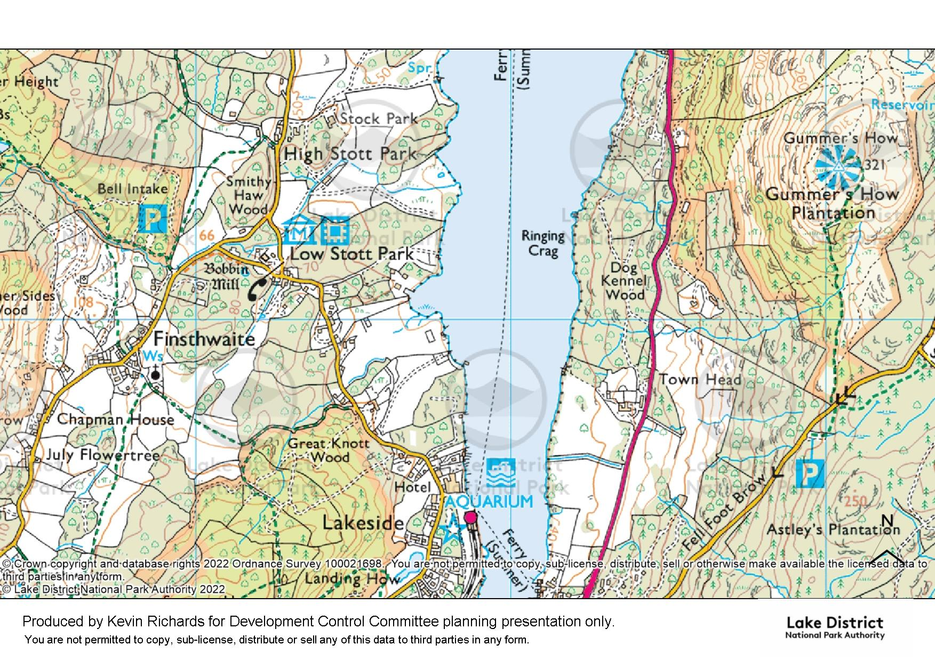
Site

Slide 6
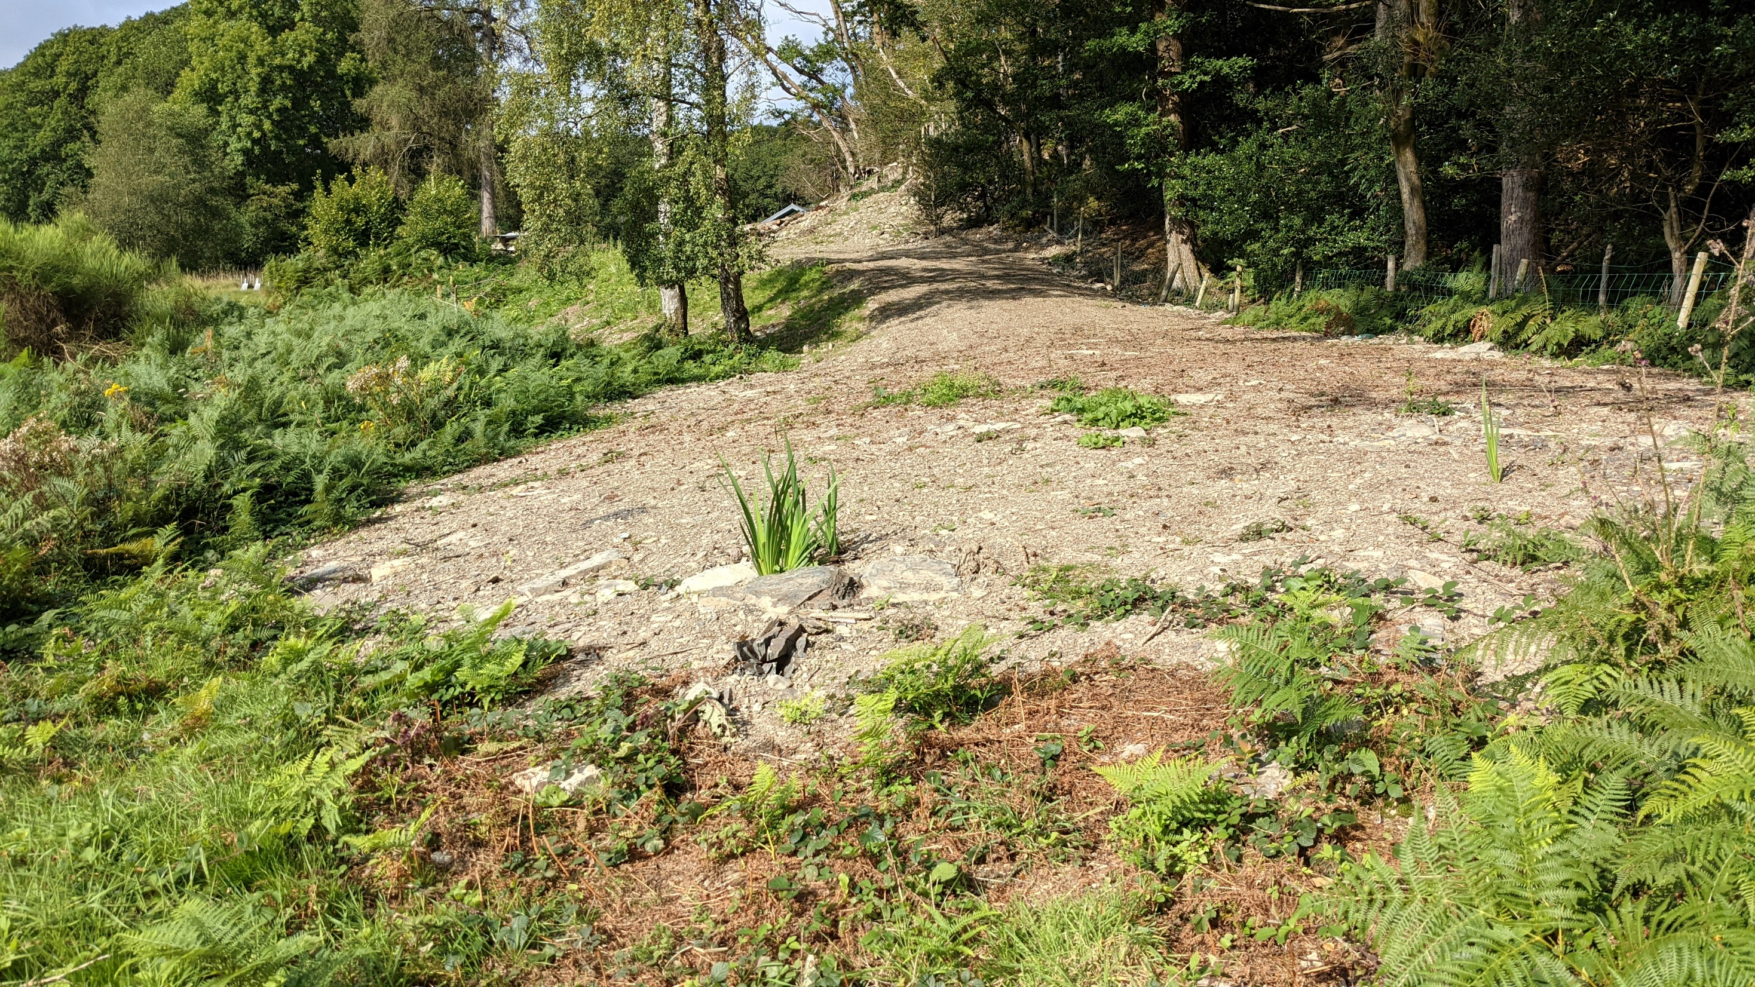

Slide 7
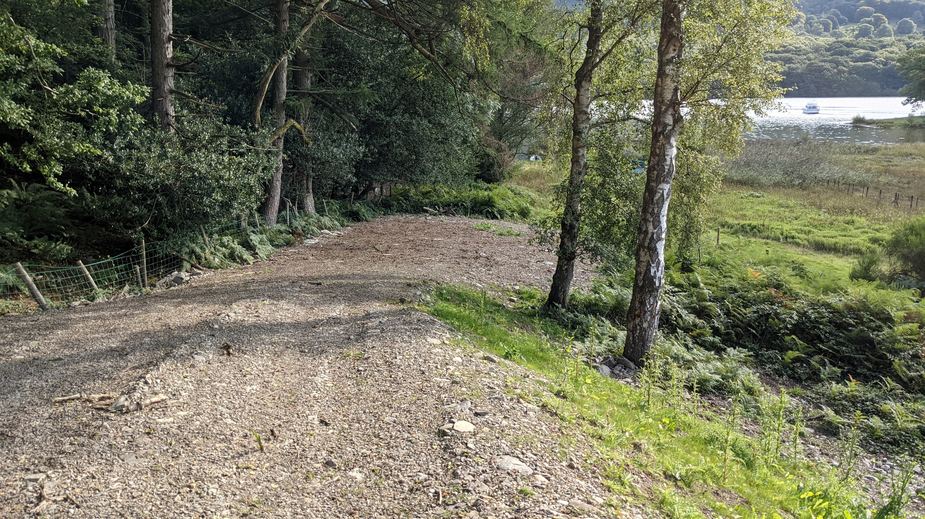

Slide 8
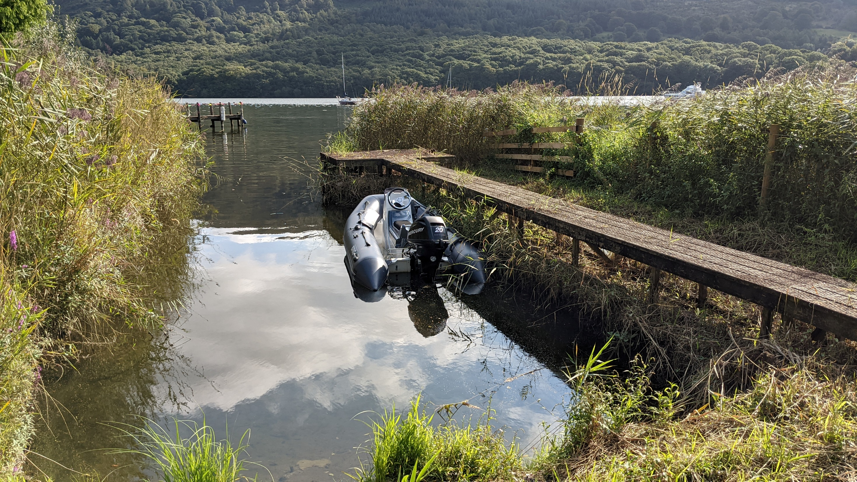

Slide 9
Site

