Slide 1
7/2021/2319 Avondale, 20 Southey Street, Keswick Change of use from guest house (Class C1 - Hotels) to use as a holiday let (Class C3 - Dwellinghouse)

Slide 2
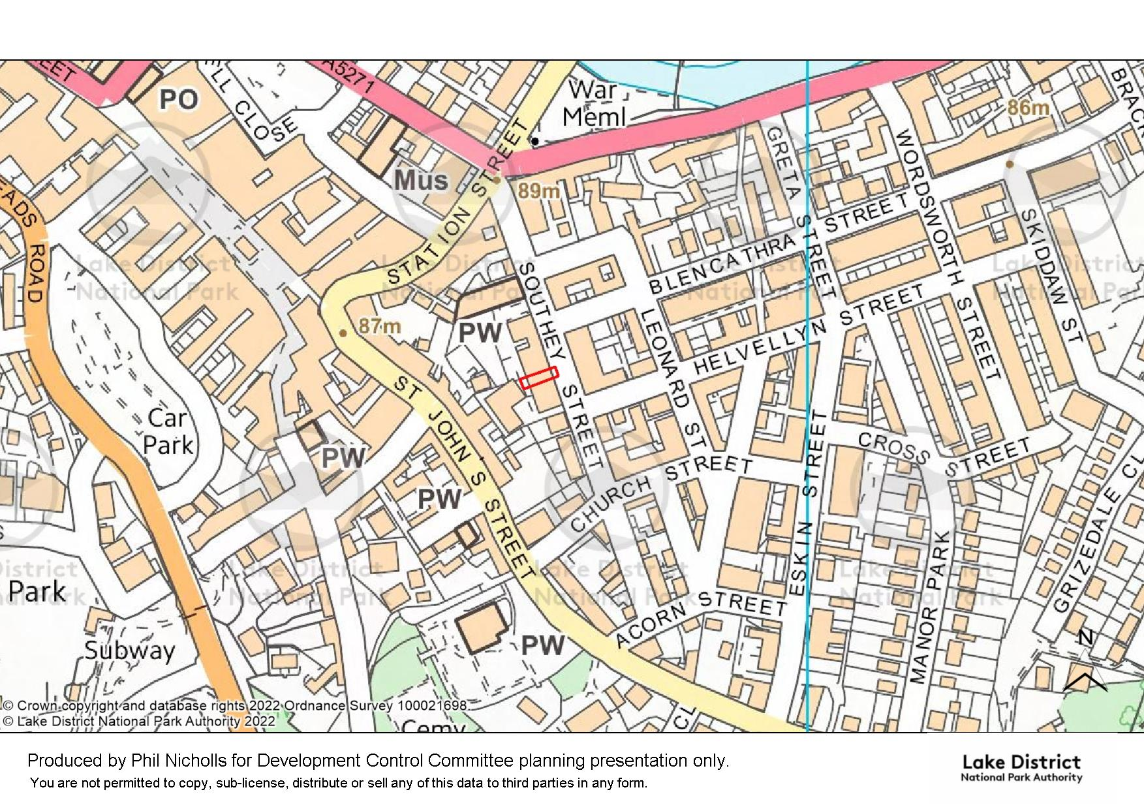

Slide 3
Slide 3

Slide 4
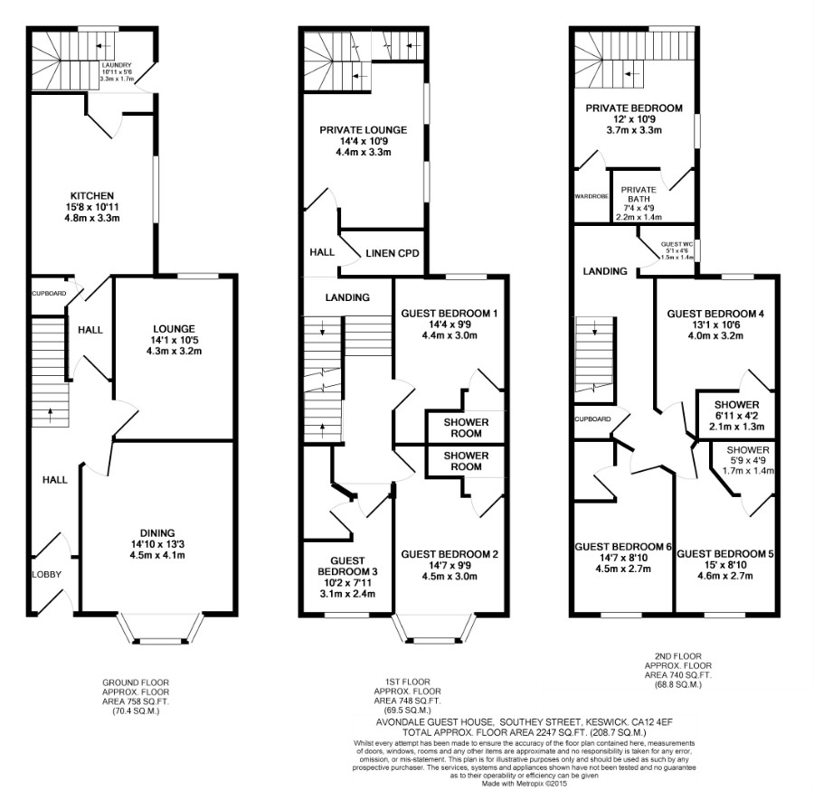
Slide 4

