Slide 1

7/2021/2292
Hazelmere, Crosthwaite Road, Keswick
Change of use from guest house to self catering accommodation

Slide 2
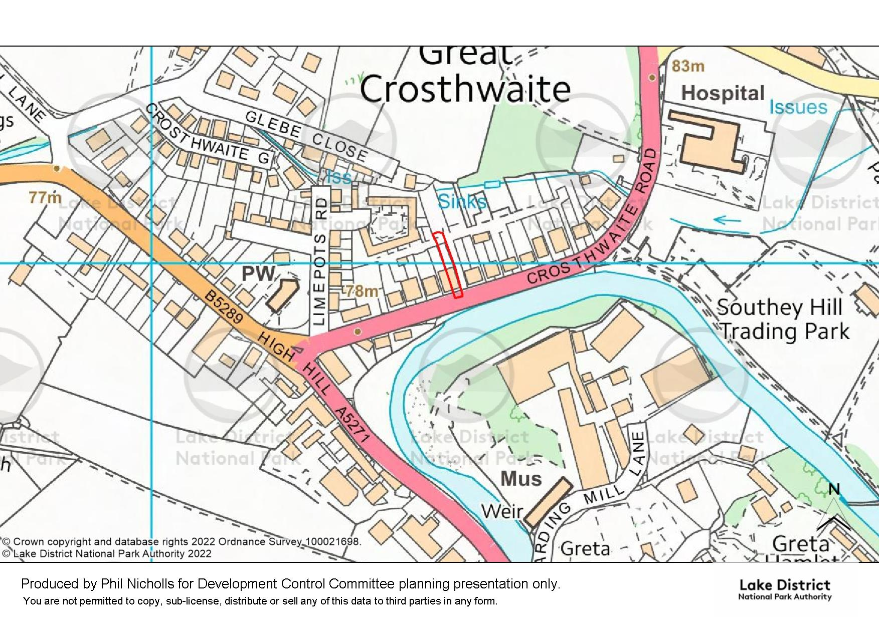


Slide 3
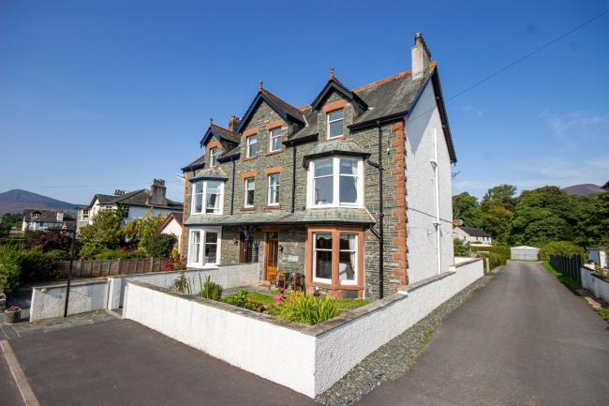
Slide 3

Slide 4
Slide 4

Slide 5


