Slide 1

7/2021/2193
Fellside Farm, Mosser, Cockermouth
Proposed conversion of the existing agricultural building to tourism accommodation (farm diversification)

Slide 2
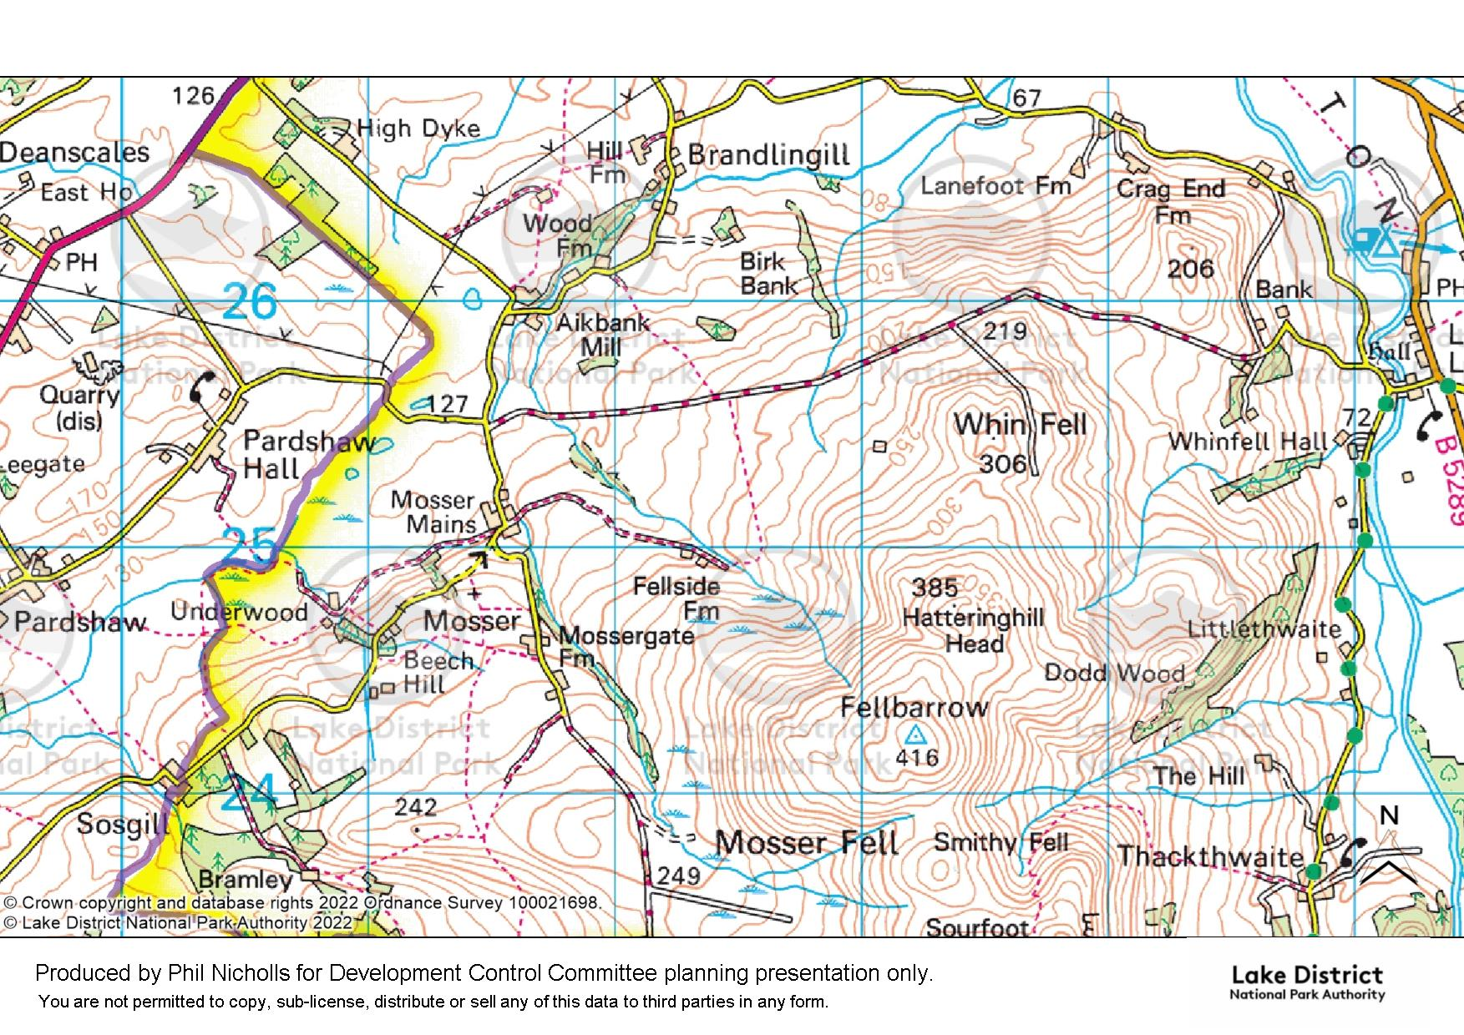


Slide 3
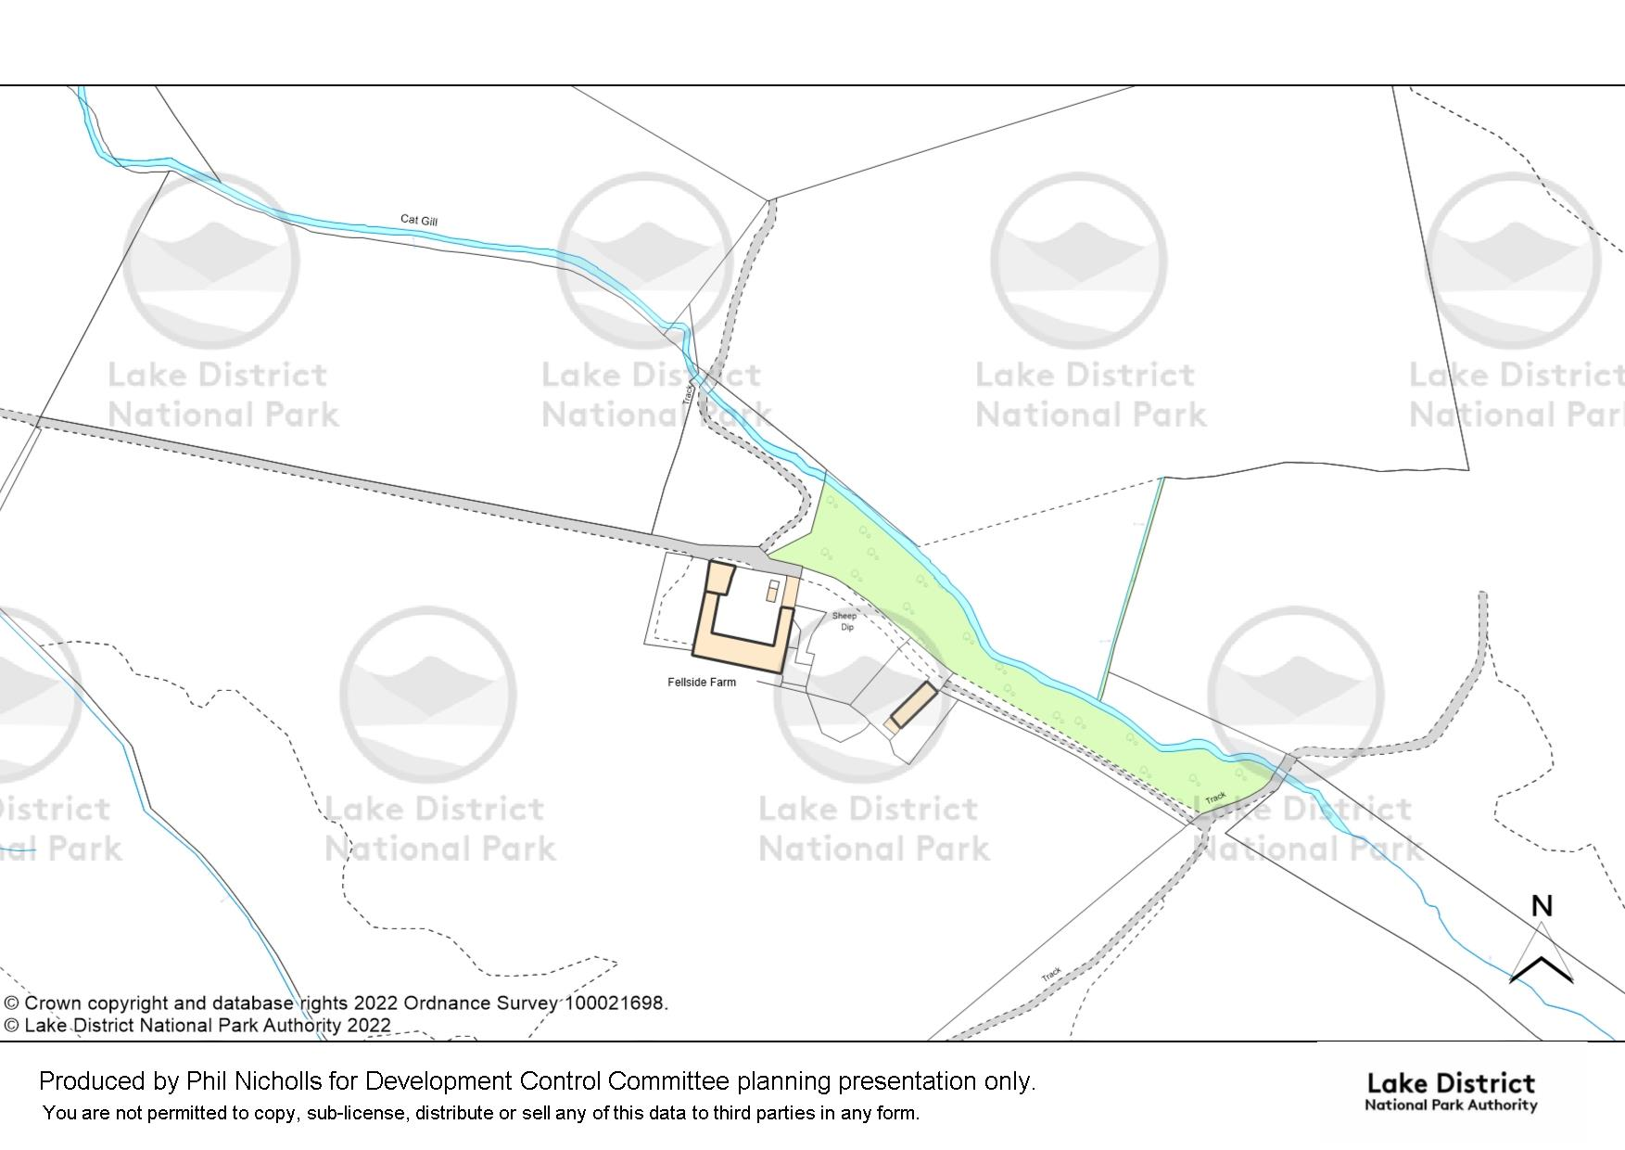
Slide 3

Slide 4
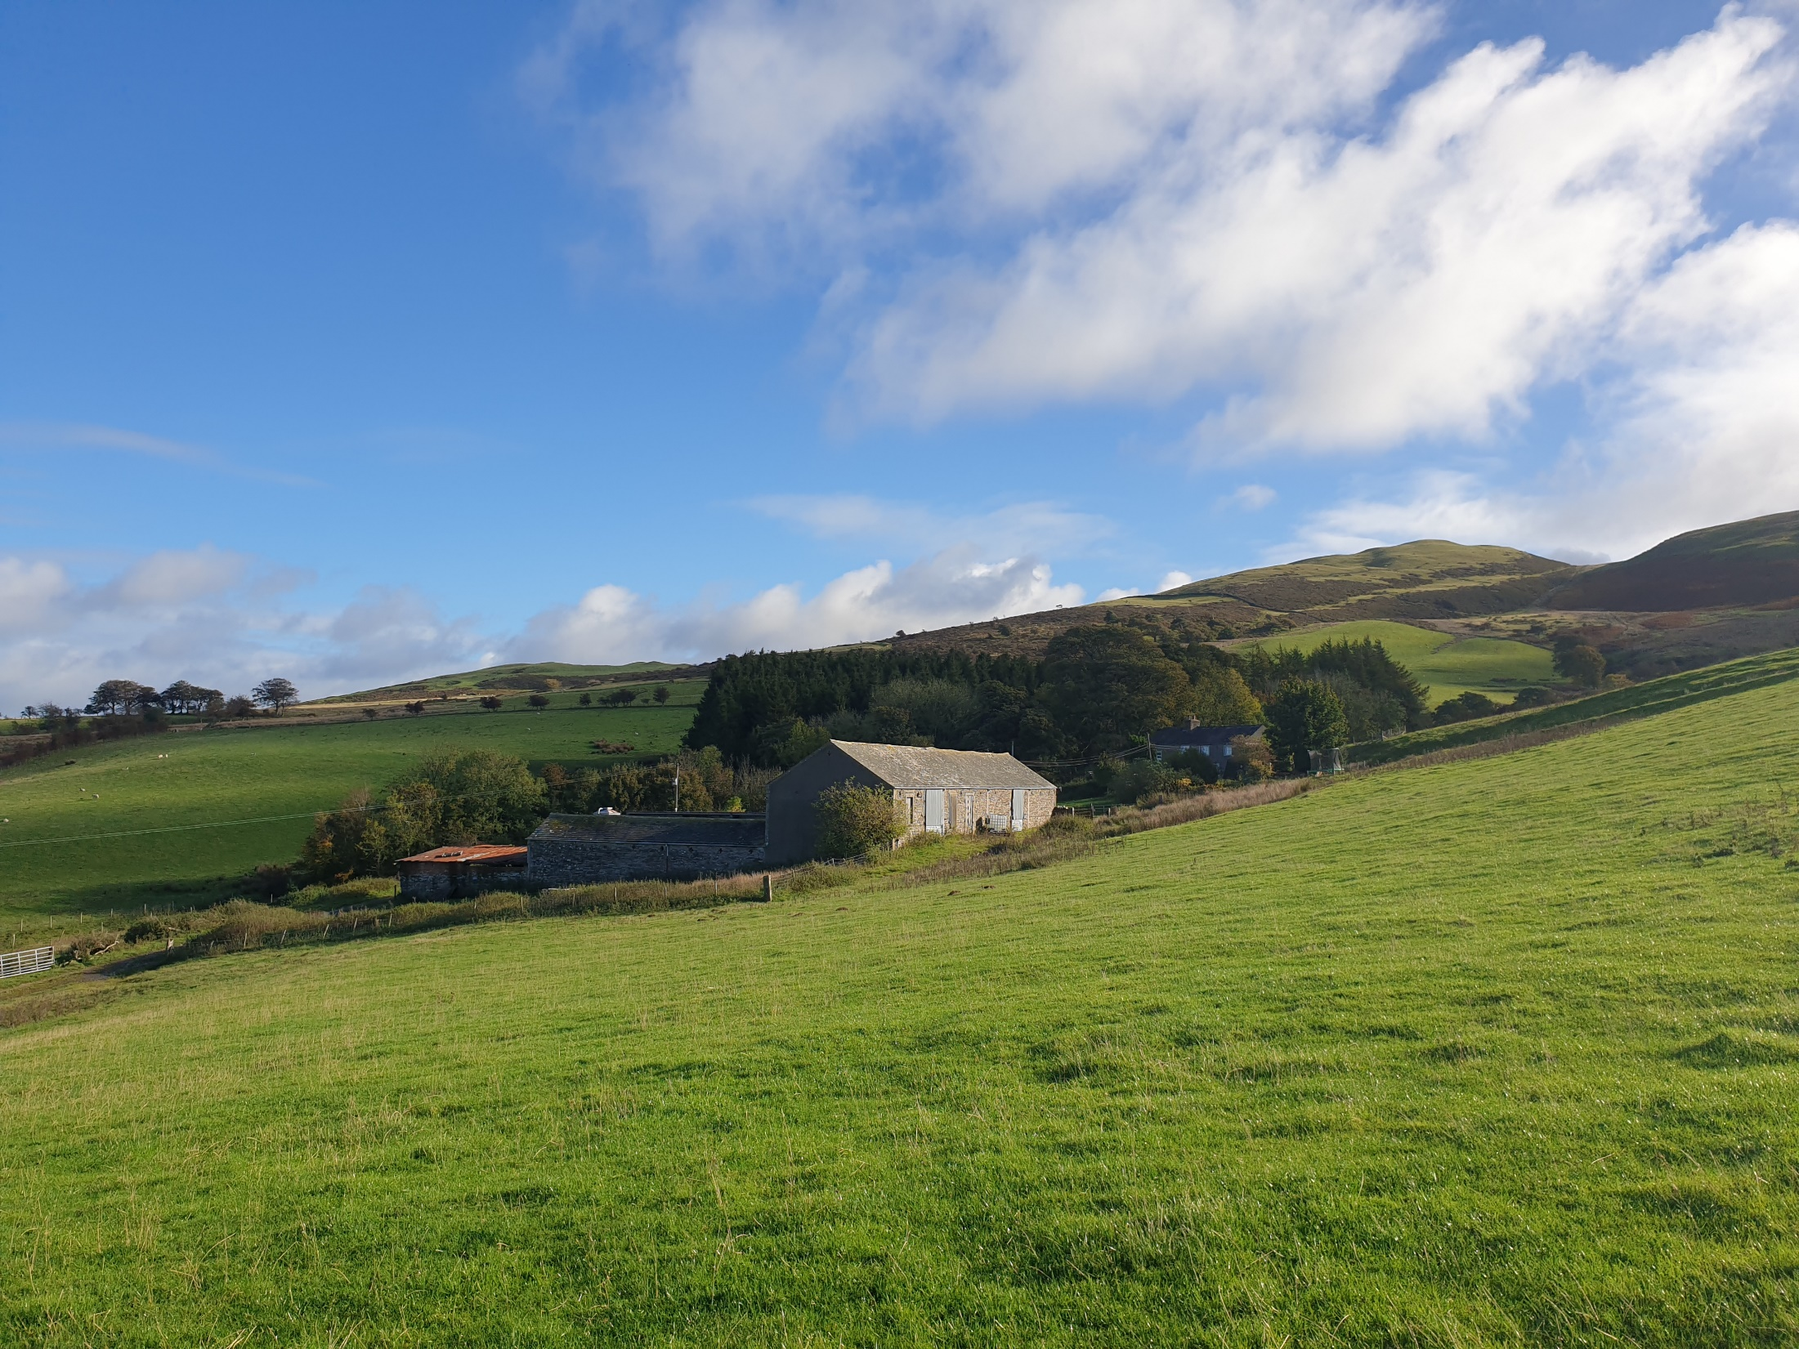
Slide 4

Slide 5
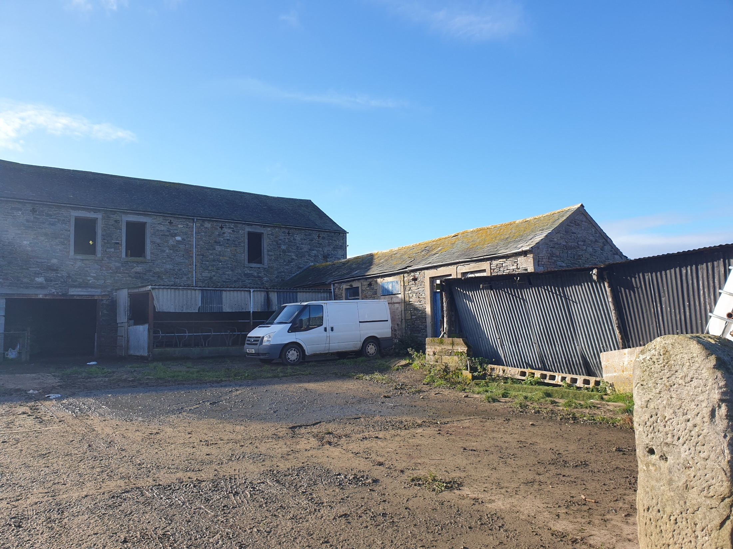


Slide 6
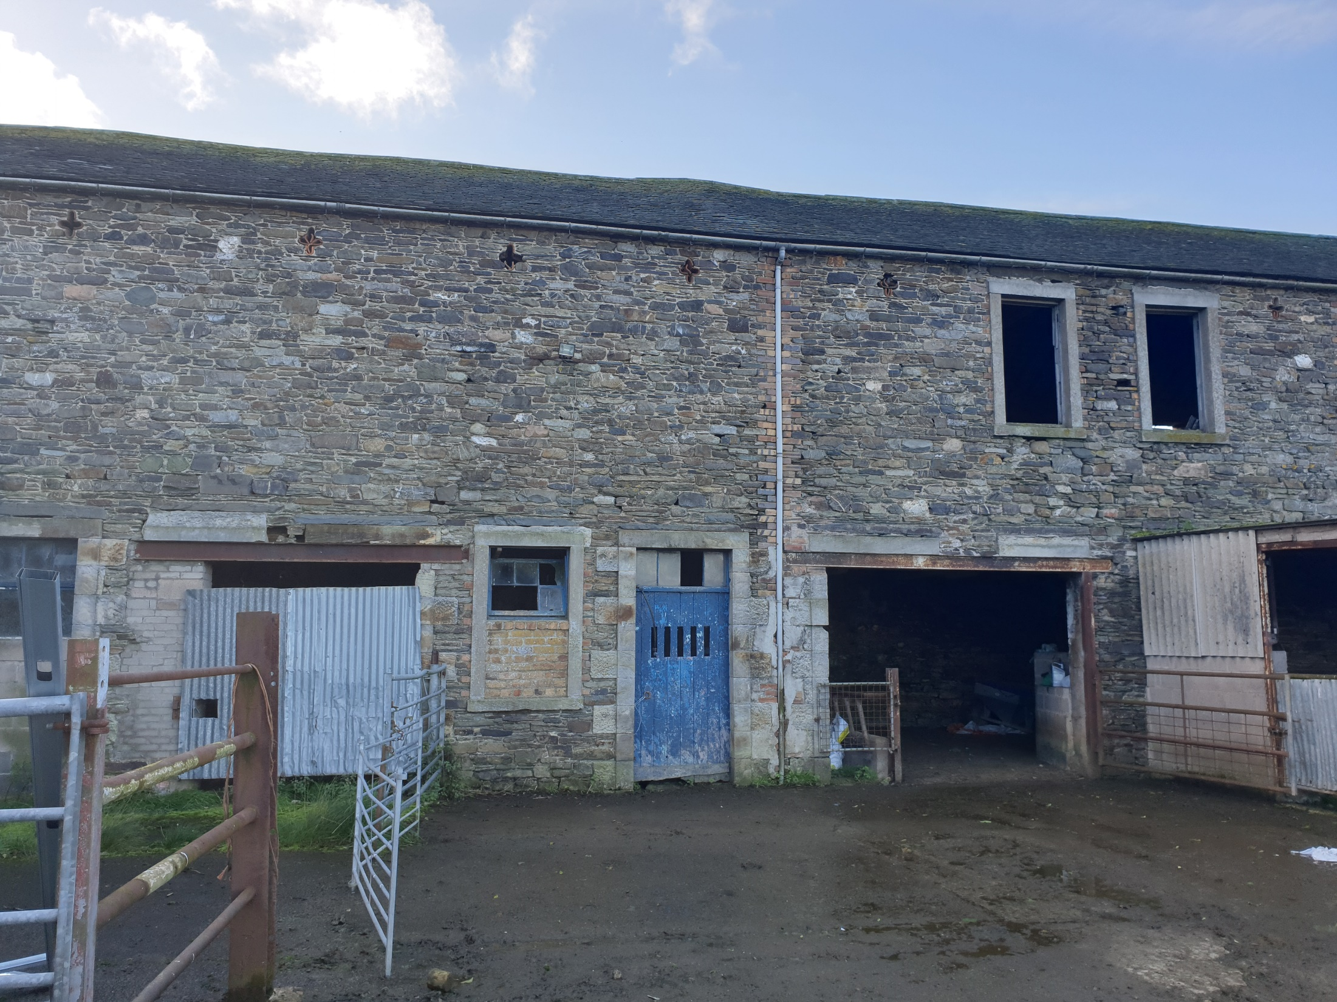
Slide 6

Slide 7
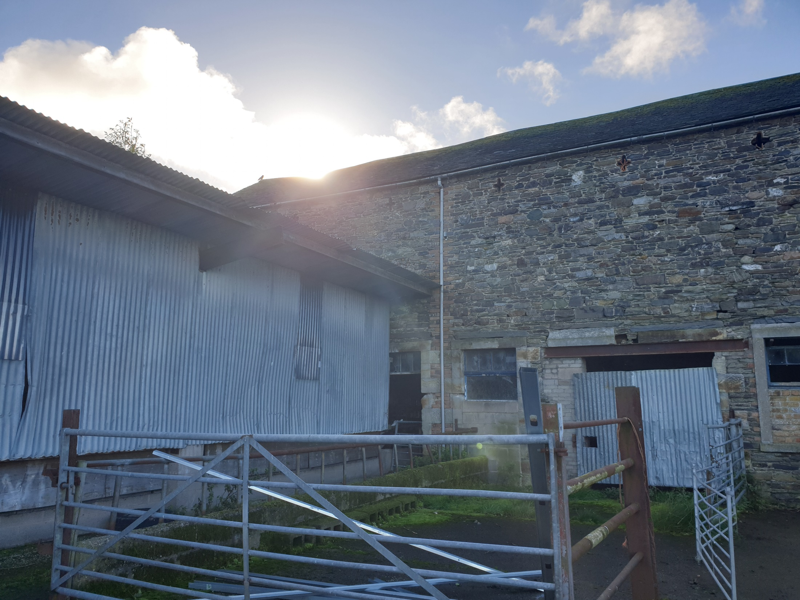
Slide 7

Slide 8
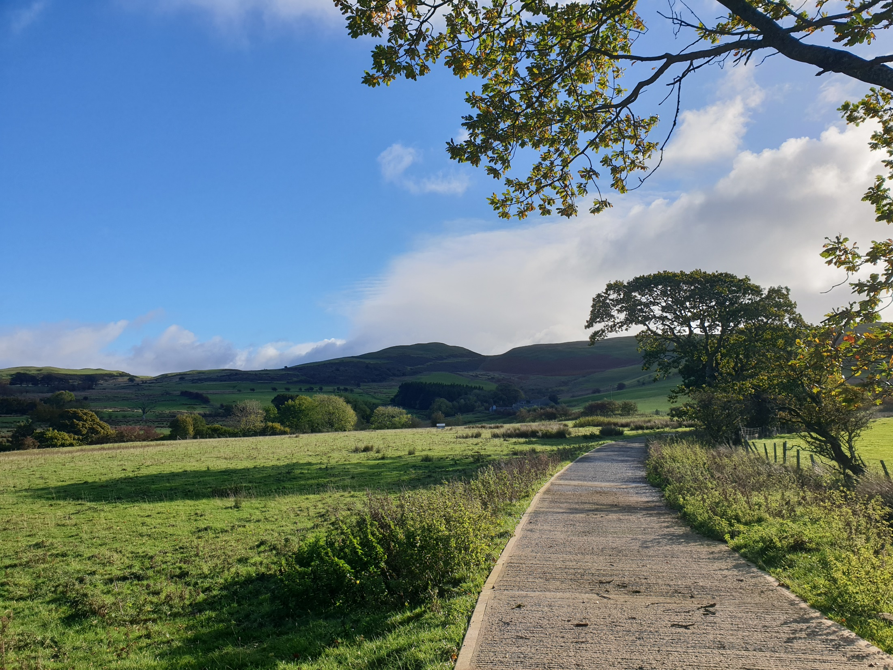
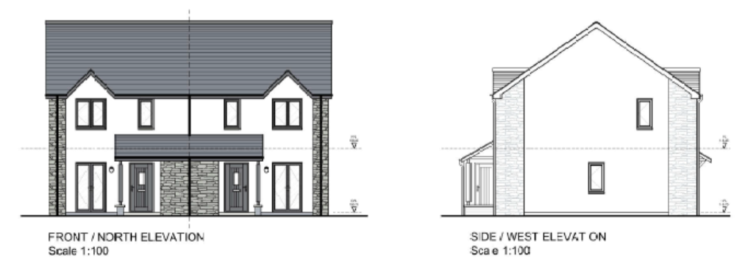
Slide 8

Slide 9
Slide 8

Slide 10
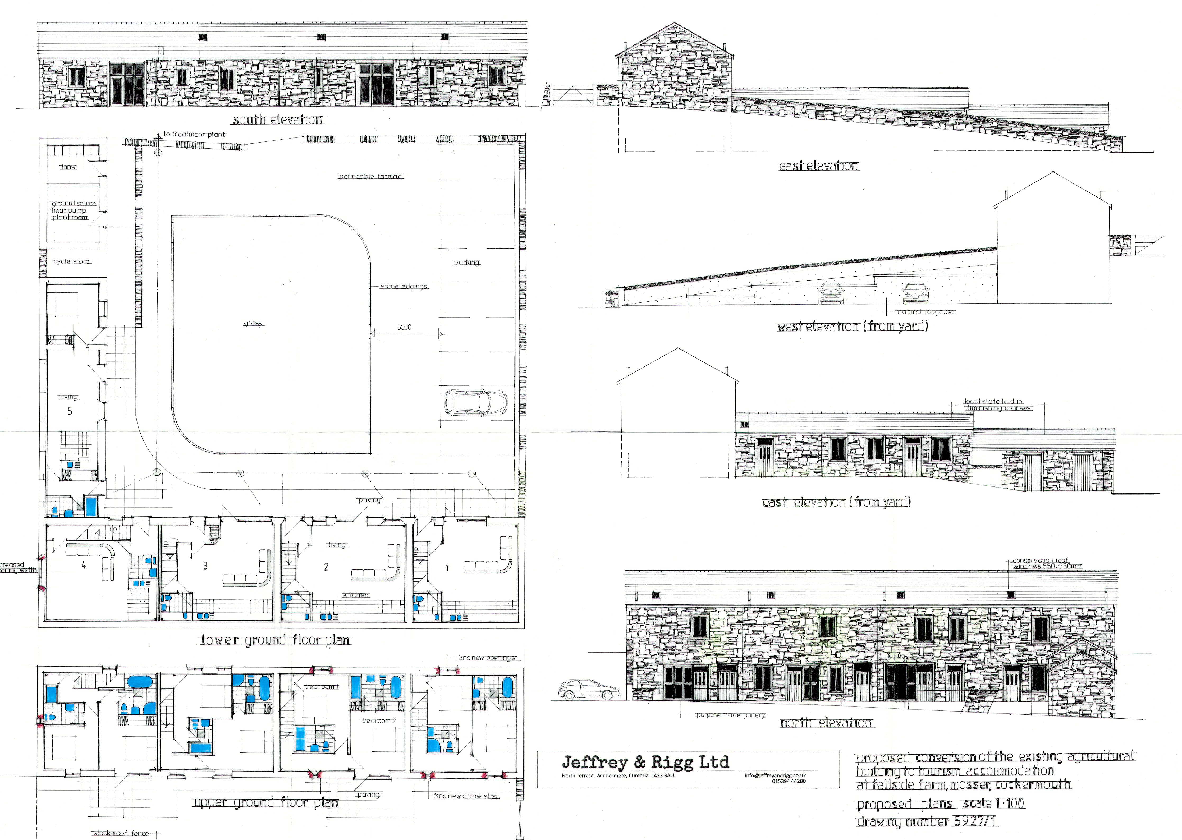
Slide 9

