Slide 1
7/2020/5555
Land off Danes Road, Staveley
Development of office/light industrial units with associated landscaping and parking

Slide 2
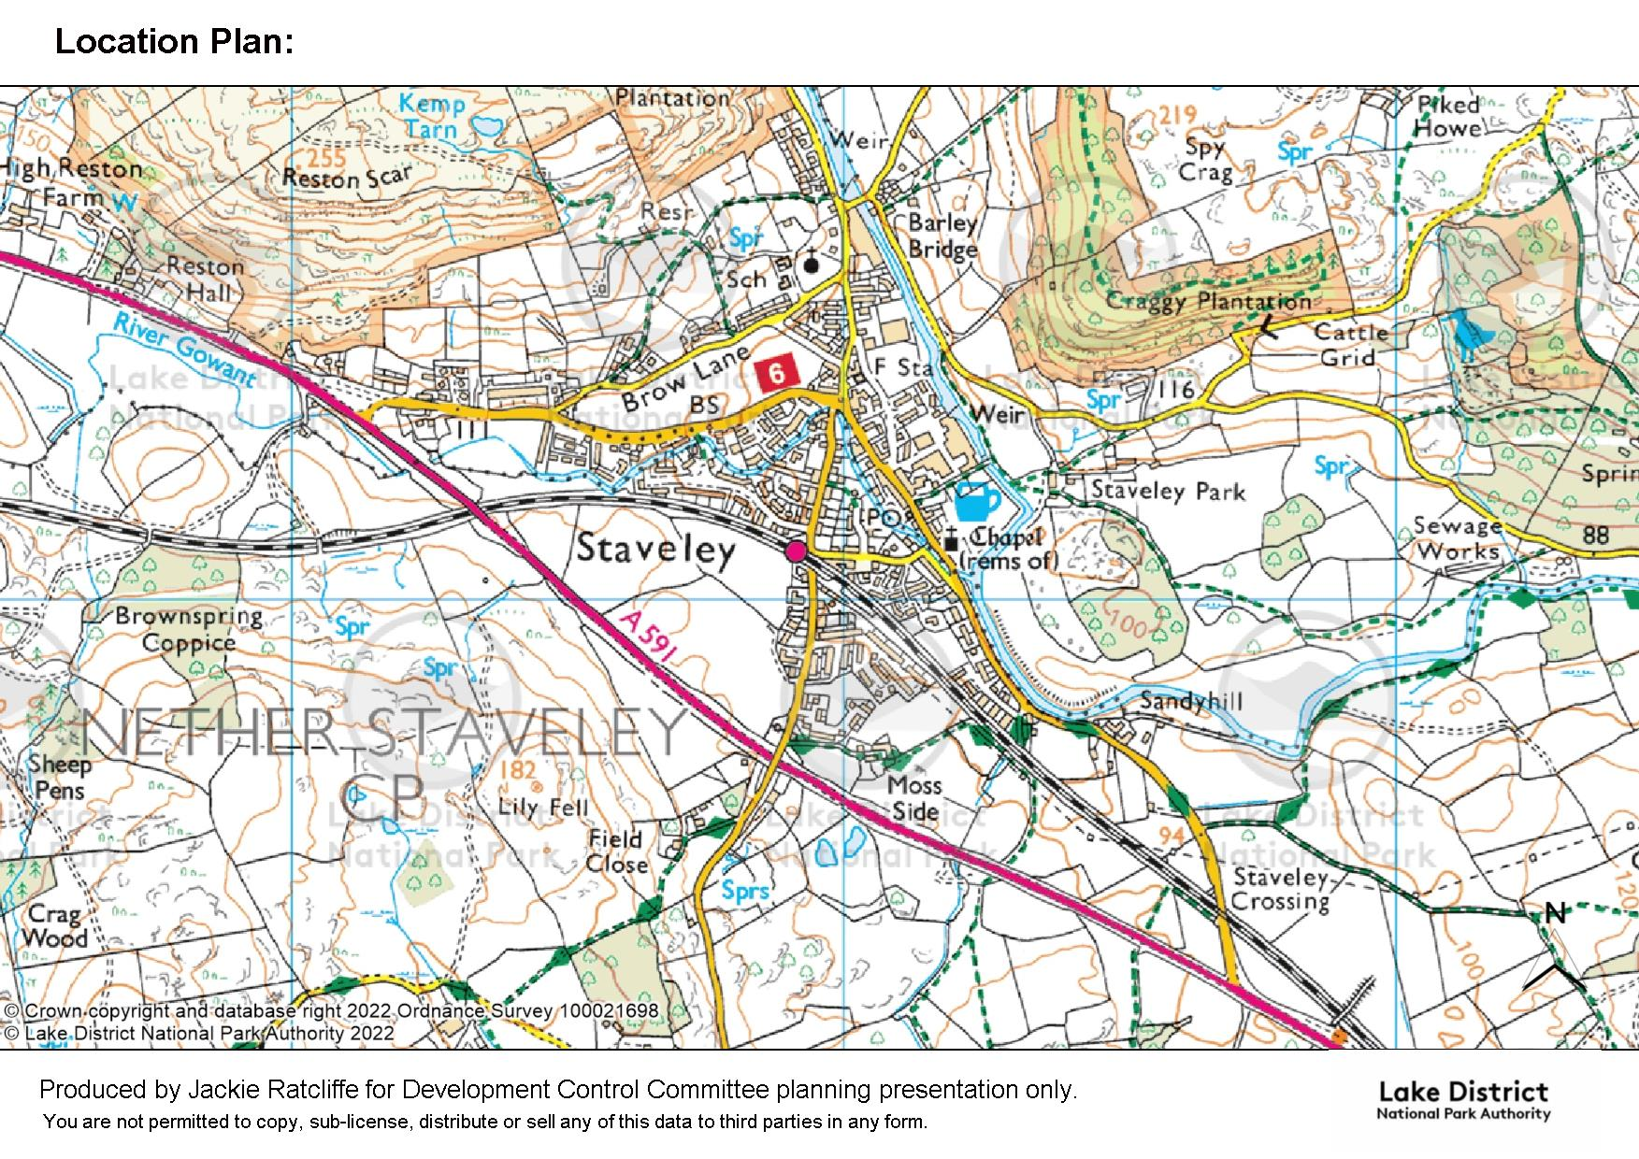
Location Plan
SITE

Slide 3
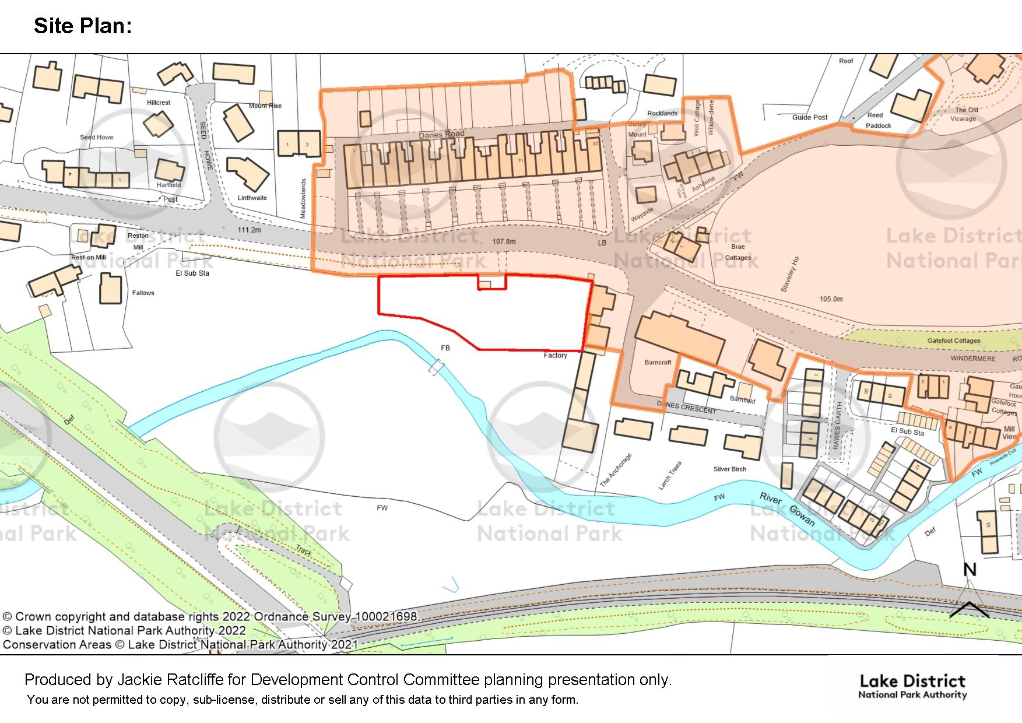
Site Plan and Conservation Area Plan
Conservation Area
SITE
A591

Slide 4
Flood Risk Zone Plan

Slide 5
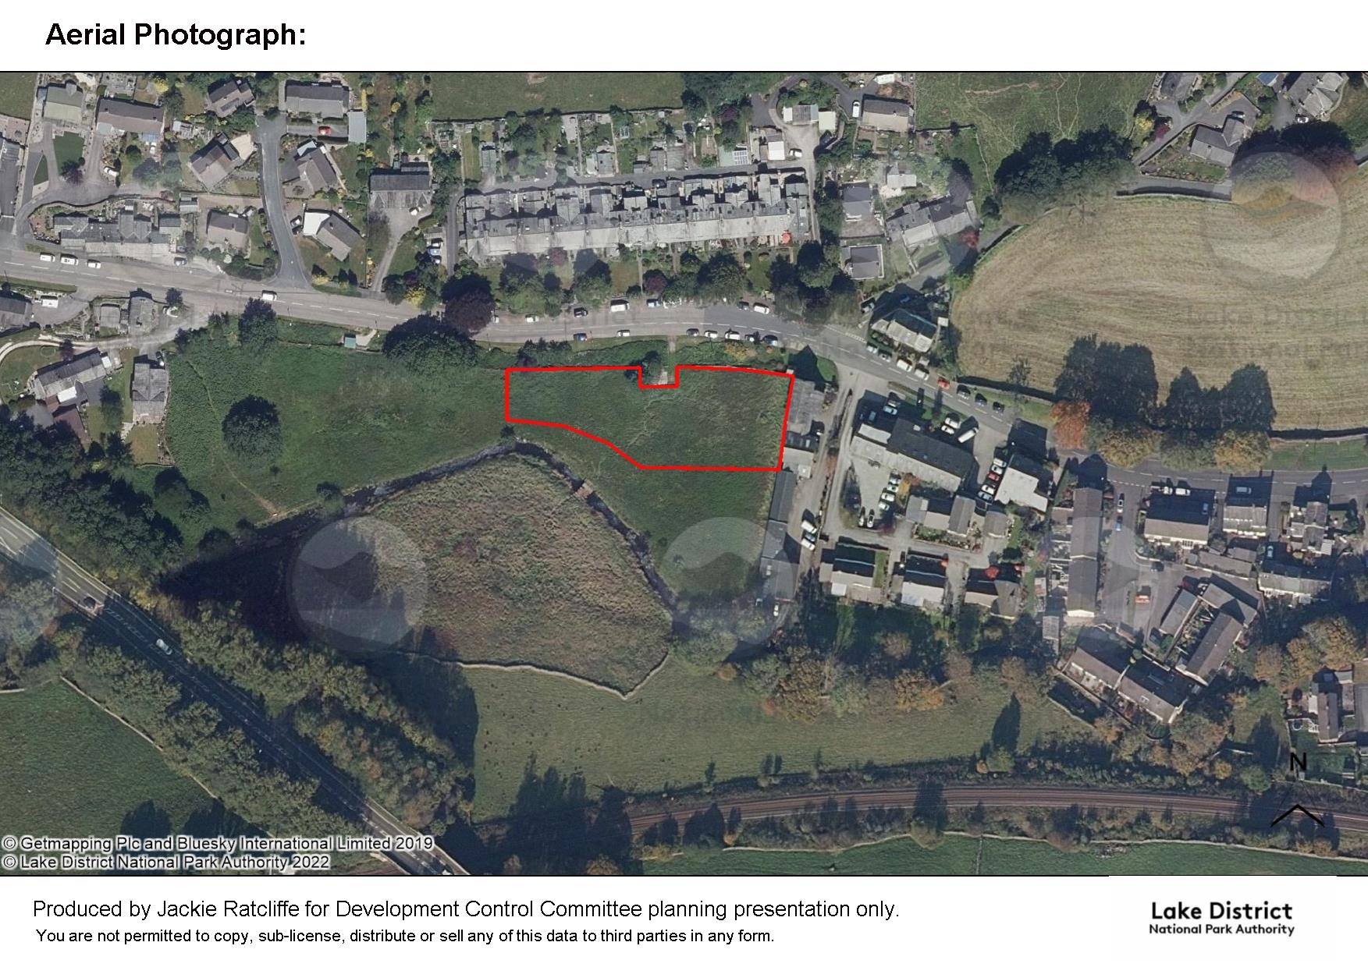
Aerial Photograph

Slide 6
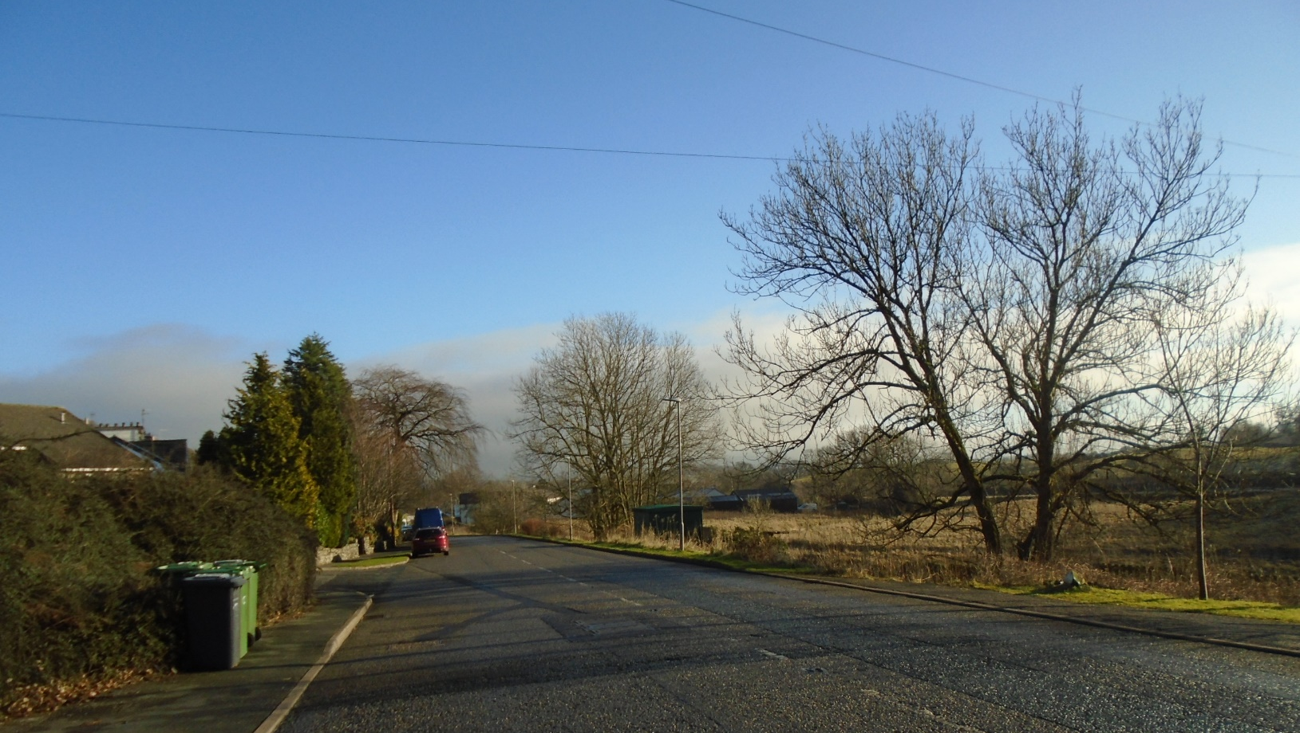
Long distance view looking eastwards
SITE

Slide 7
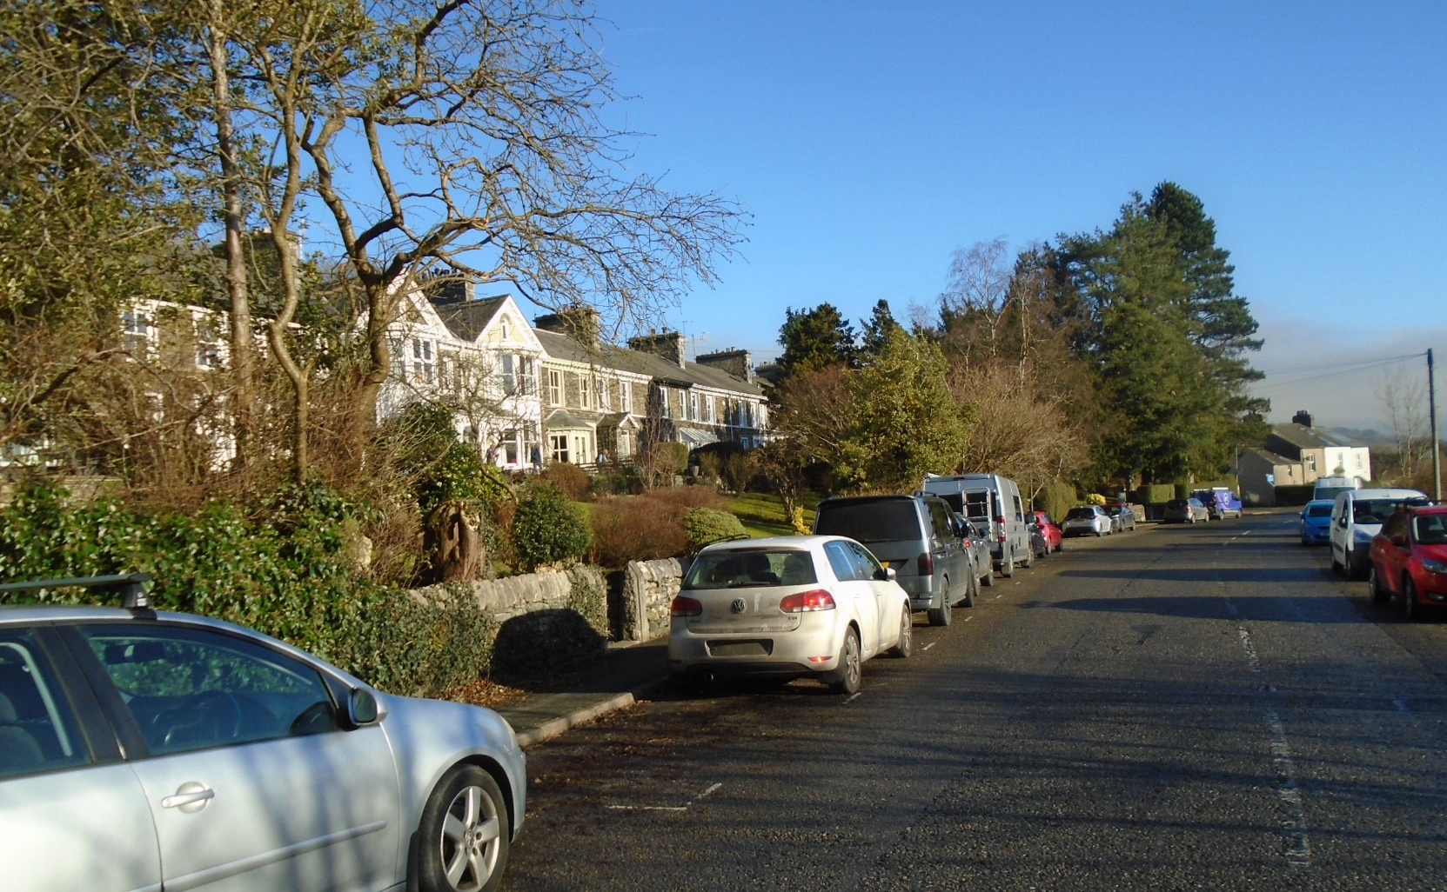
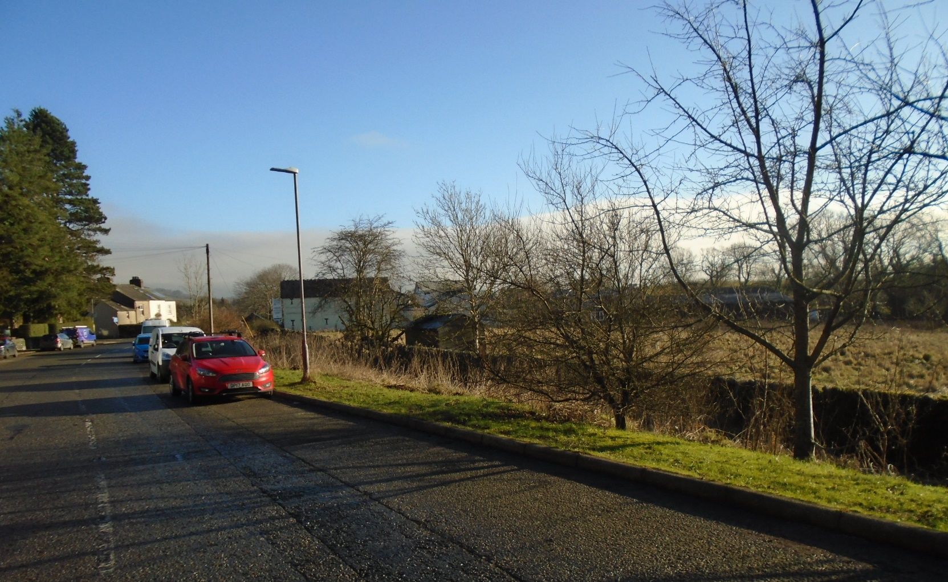
Looking east showing site relationship with Danes Road Terrace
SITE

Slide 8
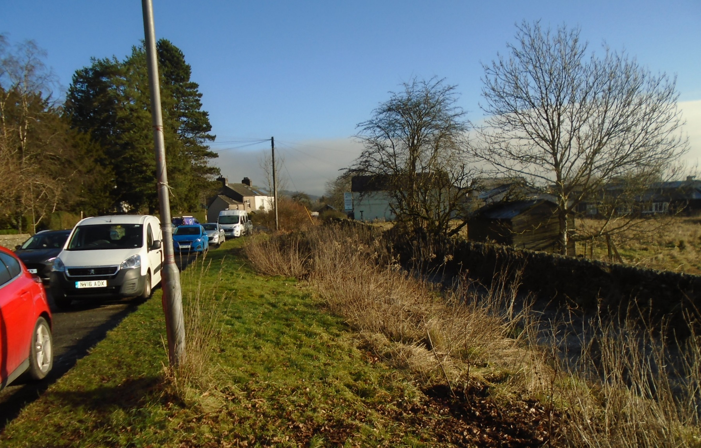
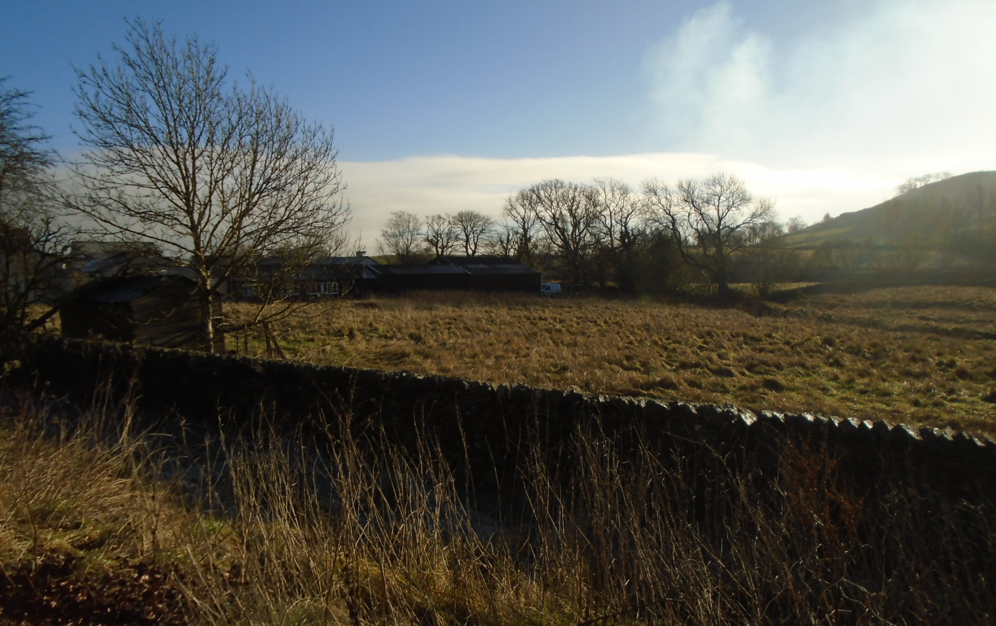
Looking across the site towards Peter Hall & Sons

Slide 9
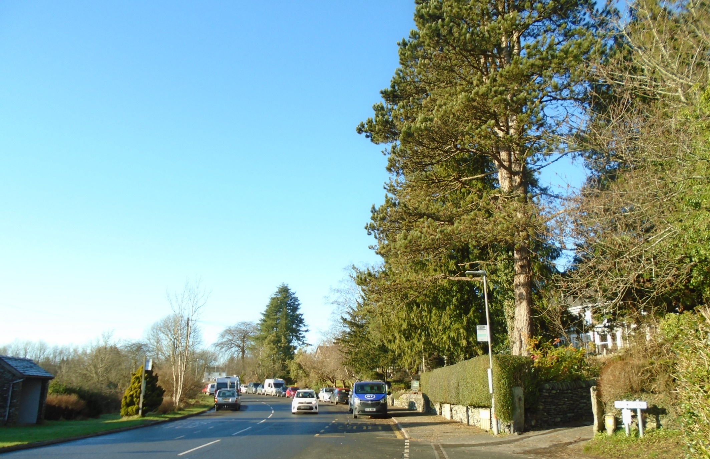
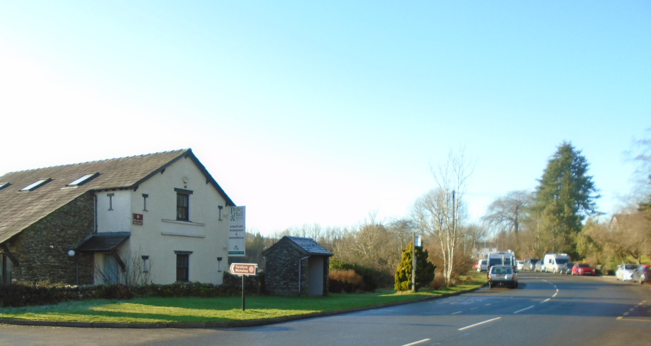
Looking west showing relationship with Danes Road Terrace
SITE

Slide 10
Proposed Site Layout Plan

Slide 11
Floor Plans – Block A

Slide 12
Elevations – Block A

Slide 13
Floor Plans – Block B

Slide 14
Elevations – Block B

Slide 15
Section through Danes Road properties and Block B
Section through Danes Road properties and Block A

Slide 16
Proposed Street Scene – Danes Road

Slide 17
Architect’s visuals of the proposed development:
These are purely for illustrative purposes and it should be noted that the backgrounds shown are not accurate

Slide 18
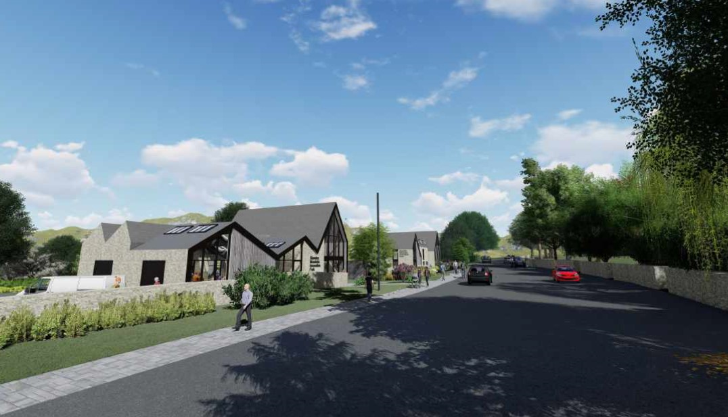

Slide 19
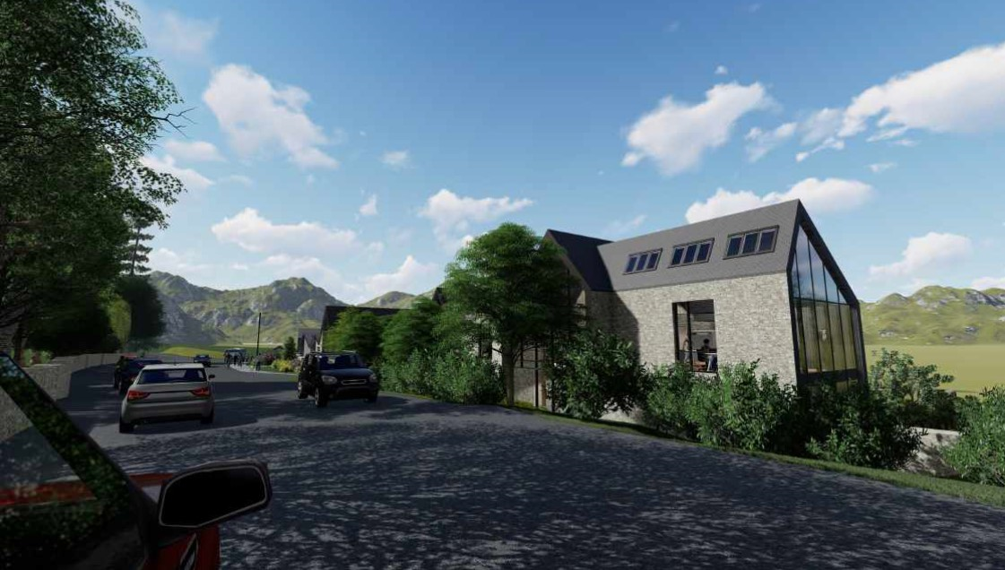

Slide 20
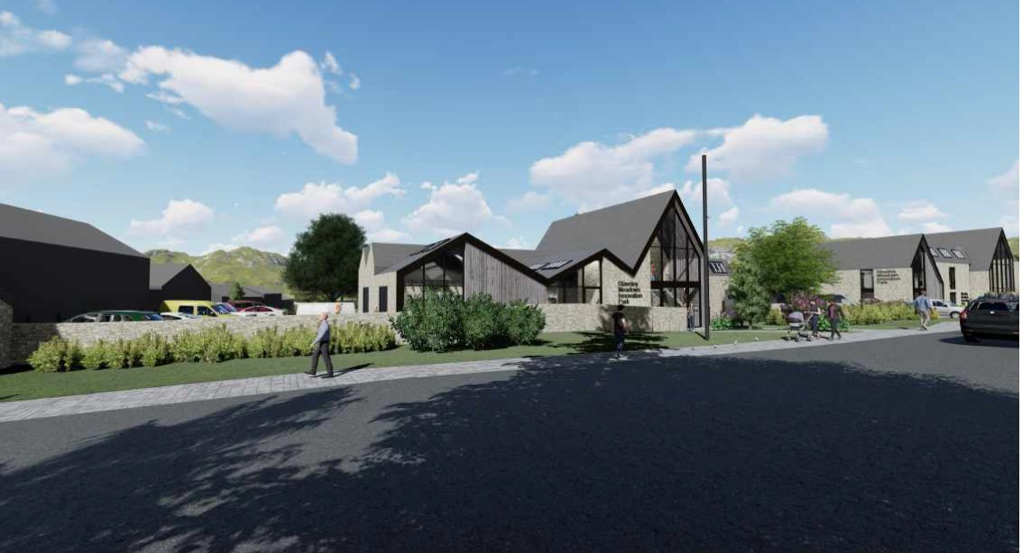

Slide 21
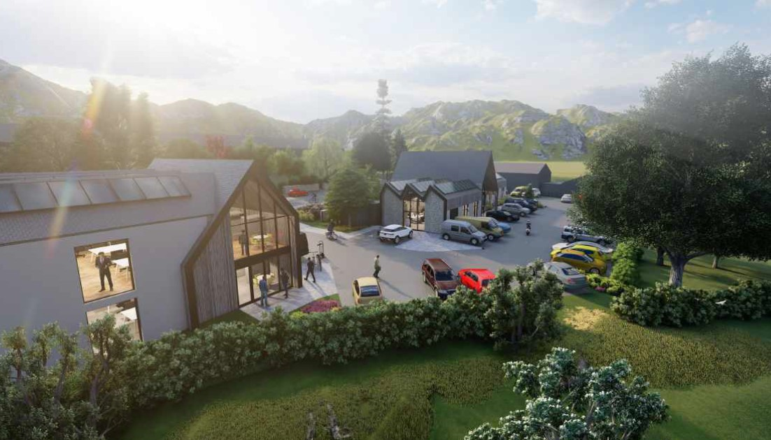

Slide 22
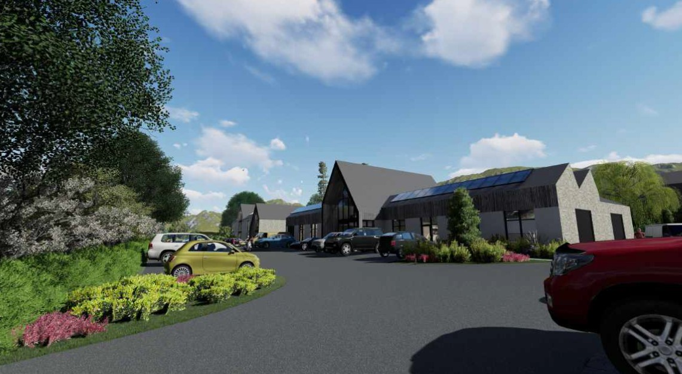

Slide 23
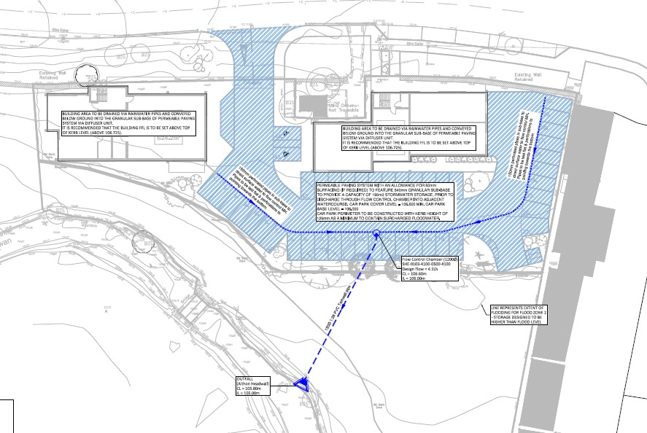
Surface Water drainage Scheme

Slide 24
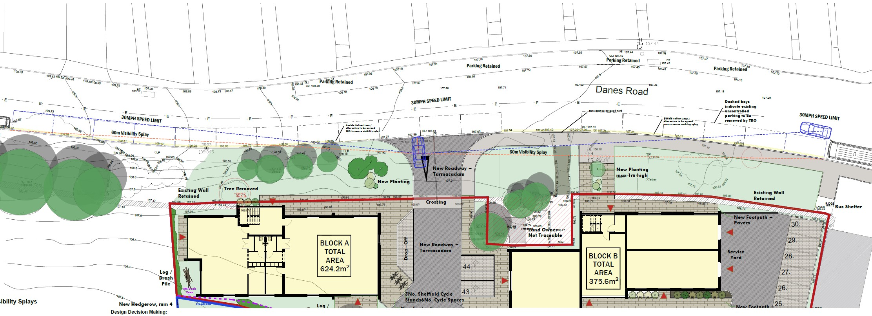
Visibility Splay and Access Plan

Slide 26
