Slide 1
7/2021/5784 Annexe, Raybarrow, Upper Oak Street, Windermere, LA23 2LB Extension and alterations including raising of roof to create habitable space and two dormer windows (following withdrawal of 7/2021/5611)

Slide 2
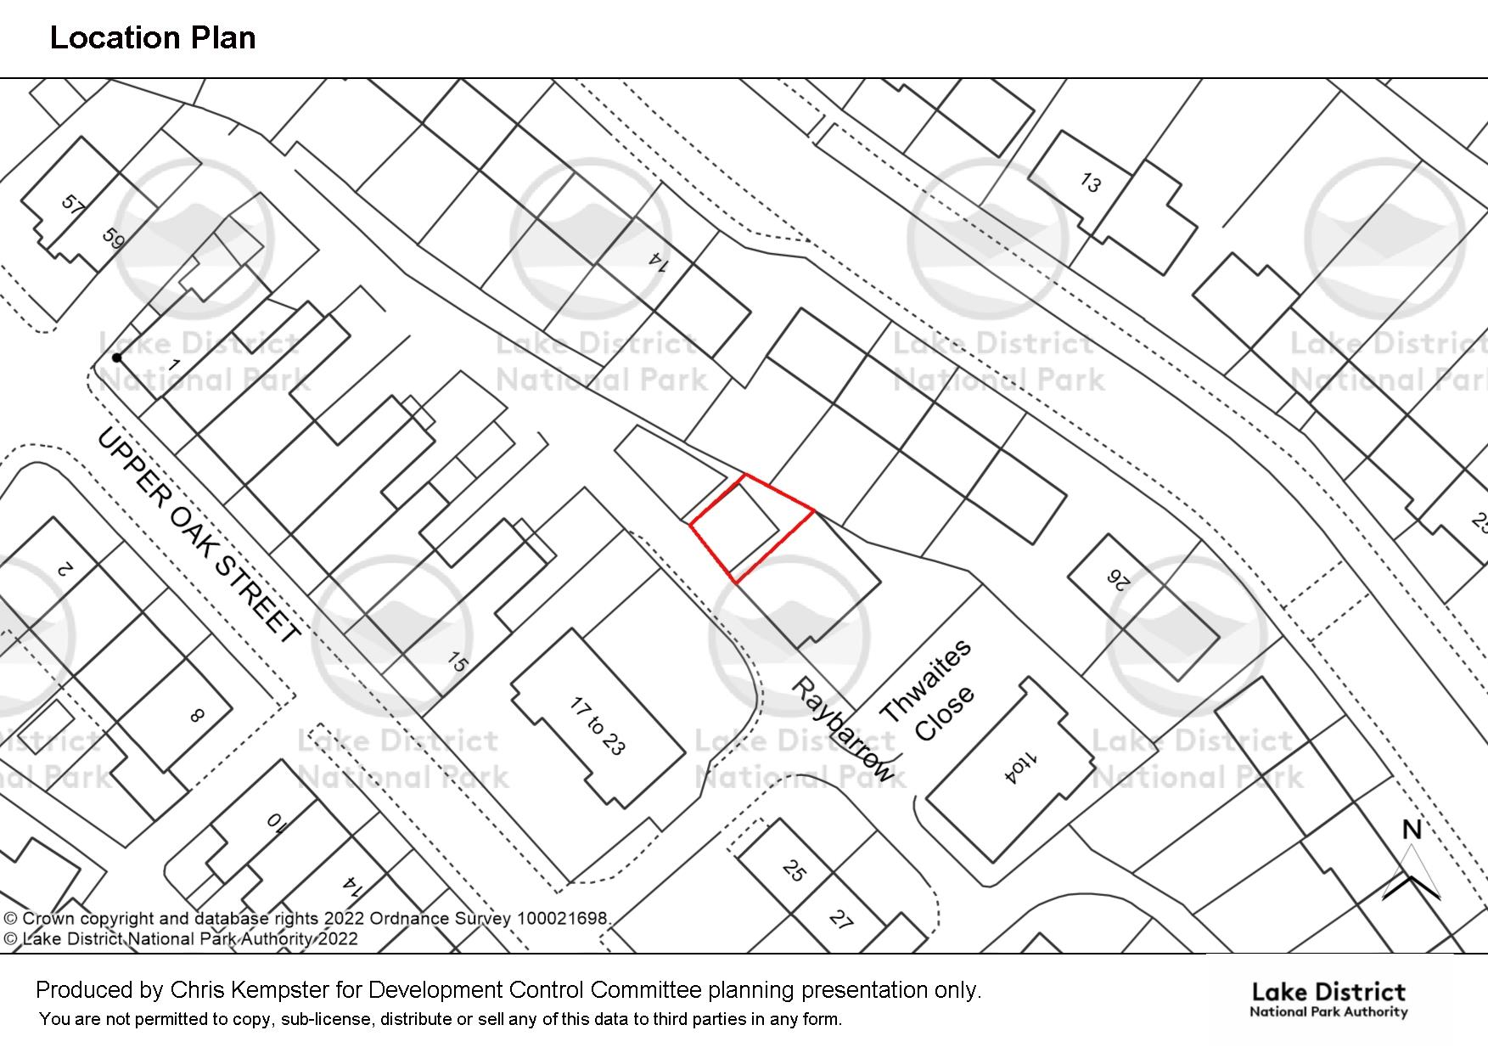
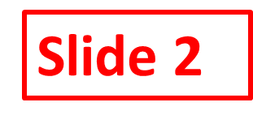

Slide 3
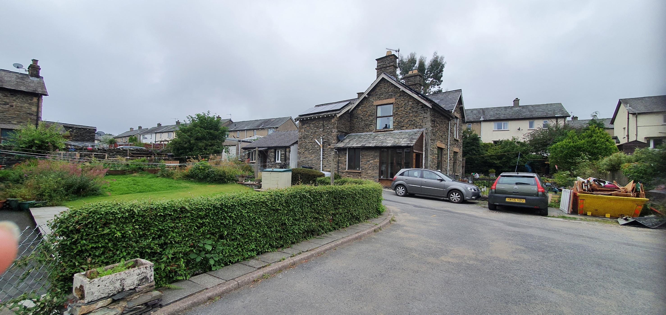
Slide 3
Annexe

Slide 4
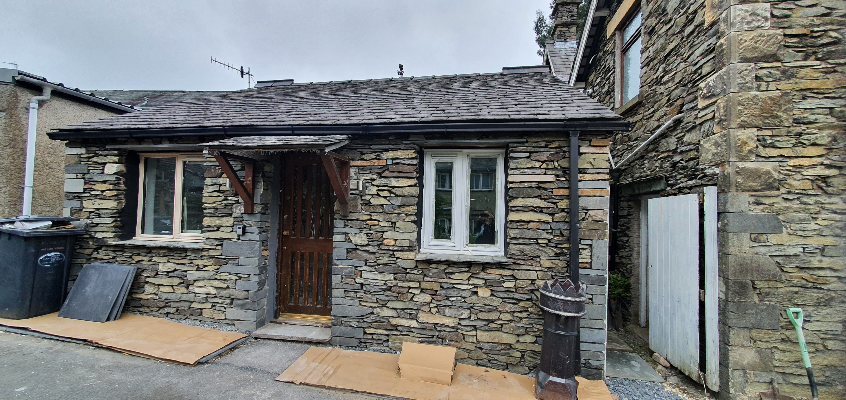
Slide 4

Slide 5
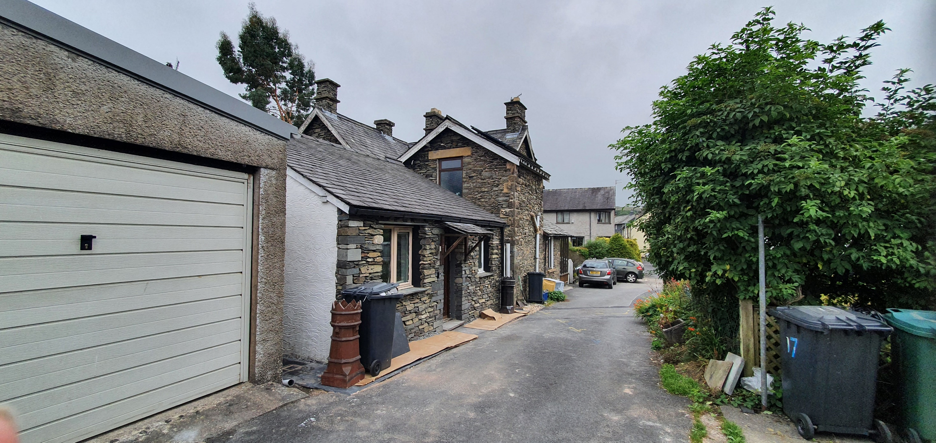

Slide 6
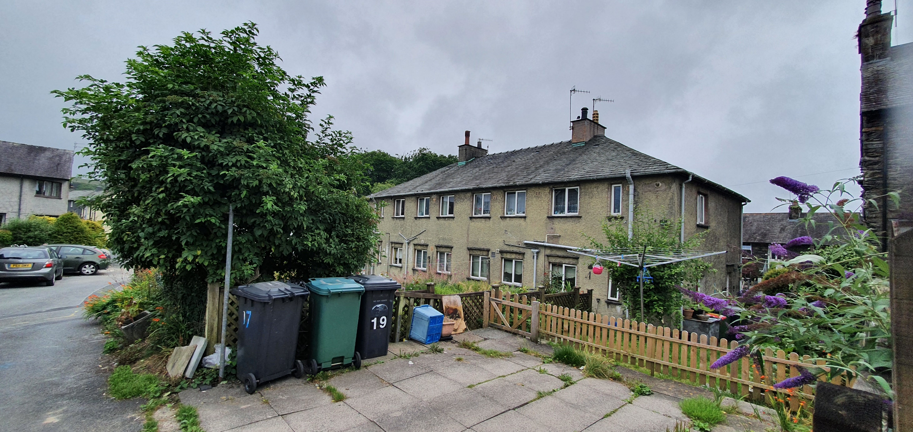
Slide 6
Neighbouring properties opposite the proposed development

Slide 7
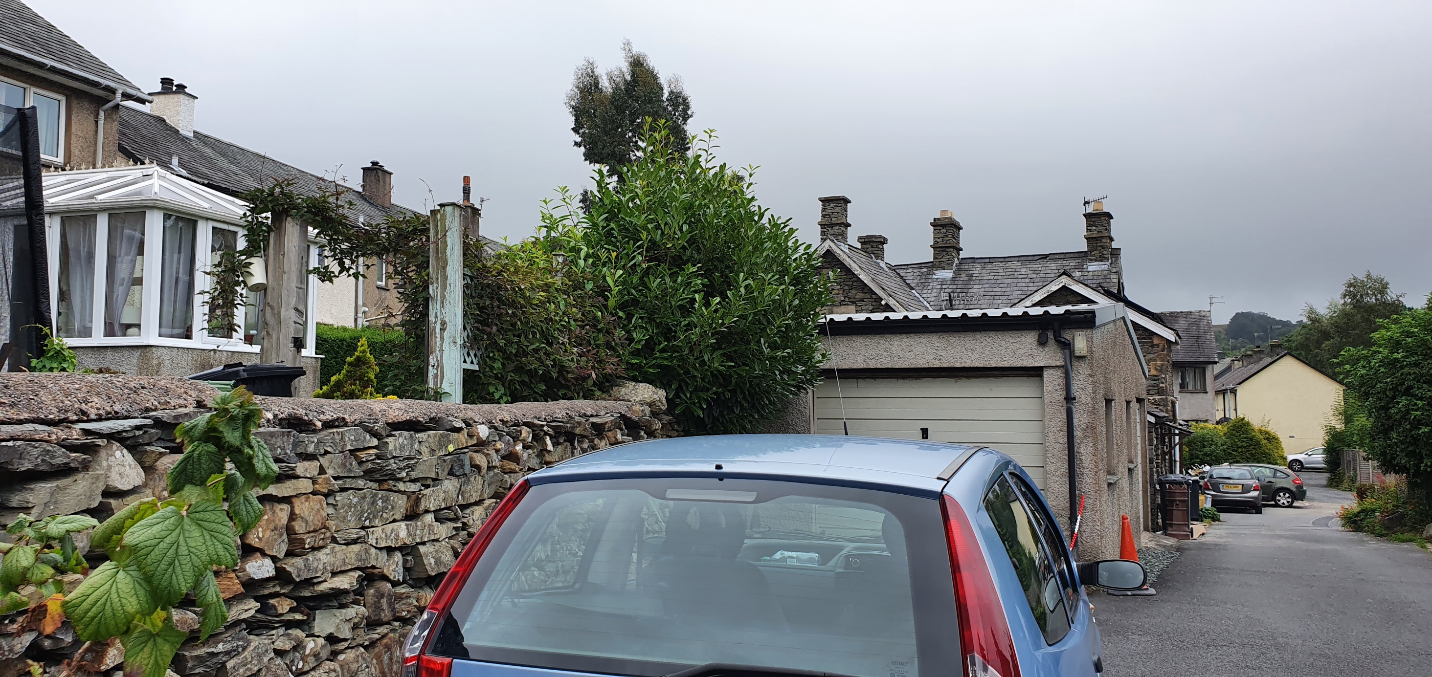
Slide 7
Annexe

Slide 8
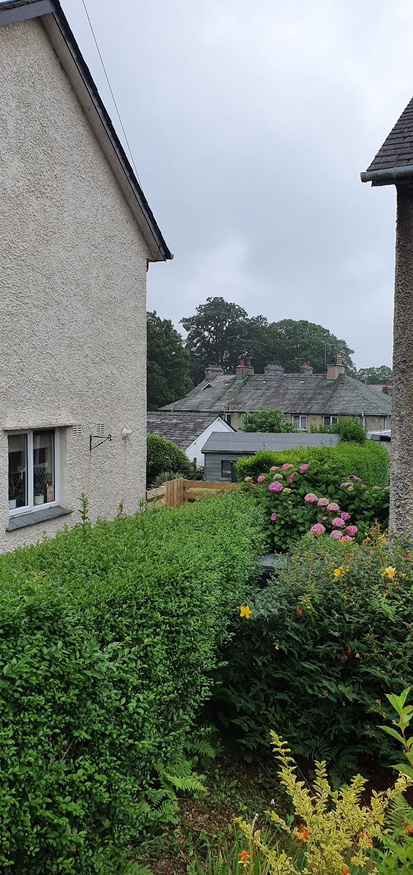
Slide 8
Annexe

Slide 9
Slide 9
Existing Elevations and Floor Plan

Slide 10
Slide 10
Proposed Elevations and Floor Plans

