Slide 1
7/2021/5599 Bigland Hall, Backbarrow, Ulverston, LA12 8PB Managers accommodation including annex, drainage and sewage treatment plant

Slide 2
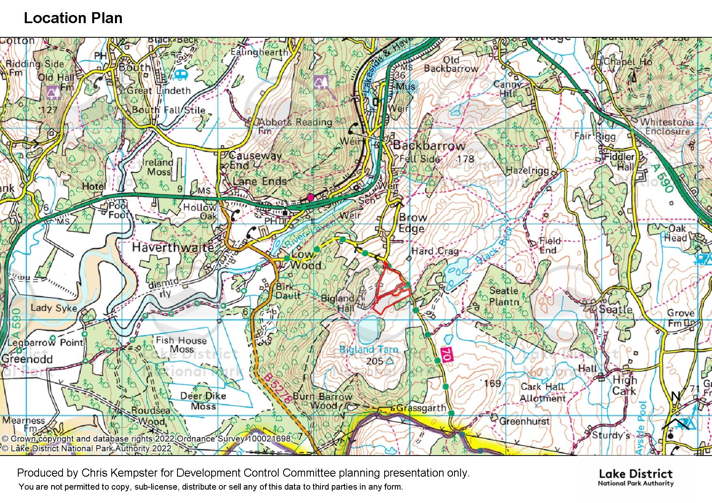
Application Site

Slide 3
Slide 3
Existing Block Plan

Slide 4
Slide 4
Proposed managers accommodation

Slide 5
Field of view of centre from managers accommodation

Slide 6
Slide 6
Proposed Ground Floor Plan

Slide 7
Slide 7
Proposed Roof Plan

Slide 8
Slide 8
Proposed Elevations

Slide 9
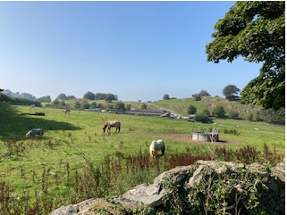
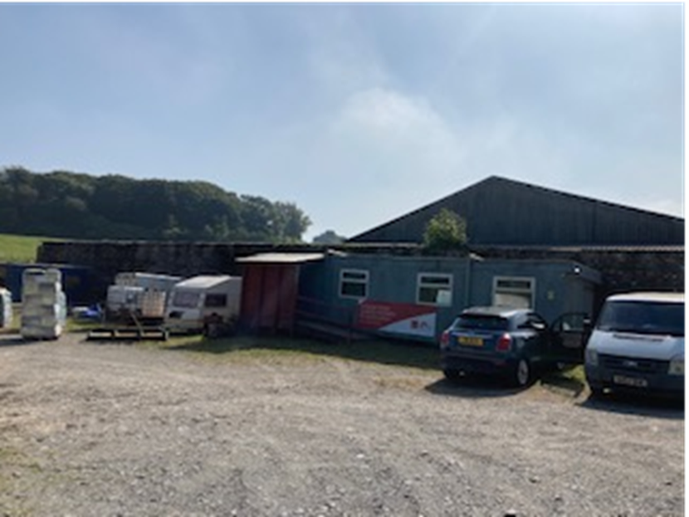
Slide 9

Slide 10
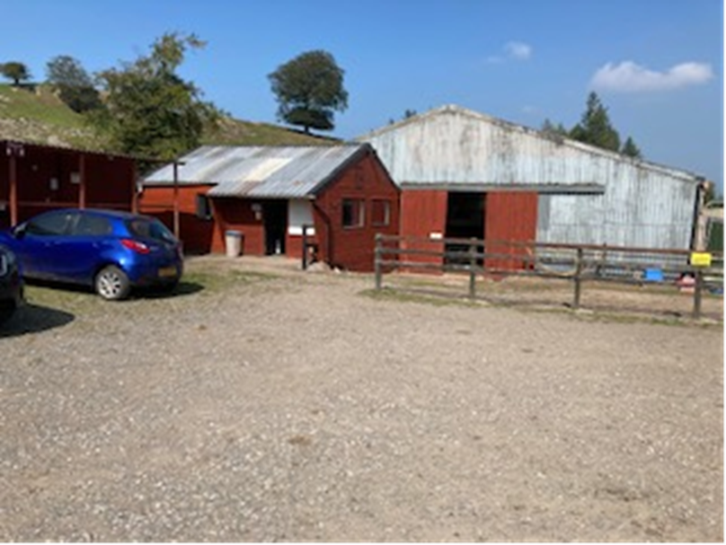
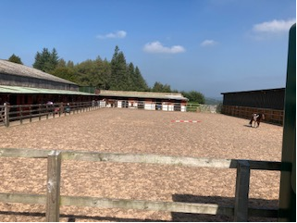
Slide 10

Slide 11
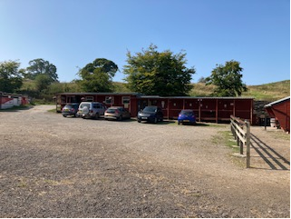
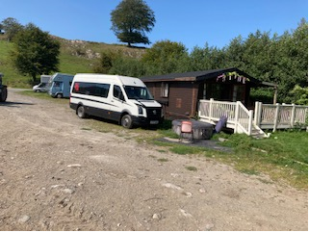
Slide 11

Slide 12
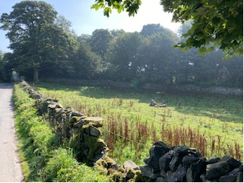
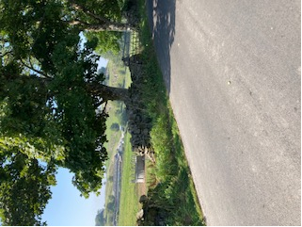
Slide 12

Slide 13
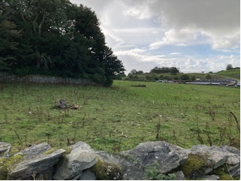
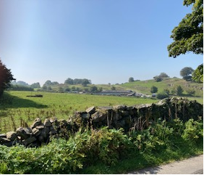
Slide 13

